Slide 1

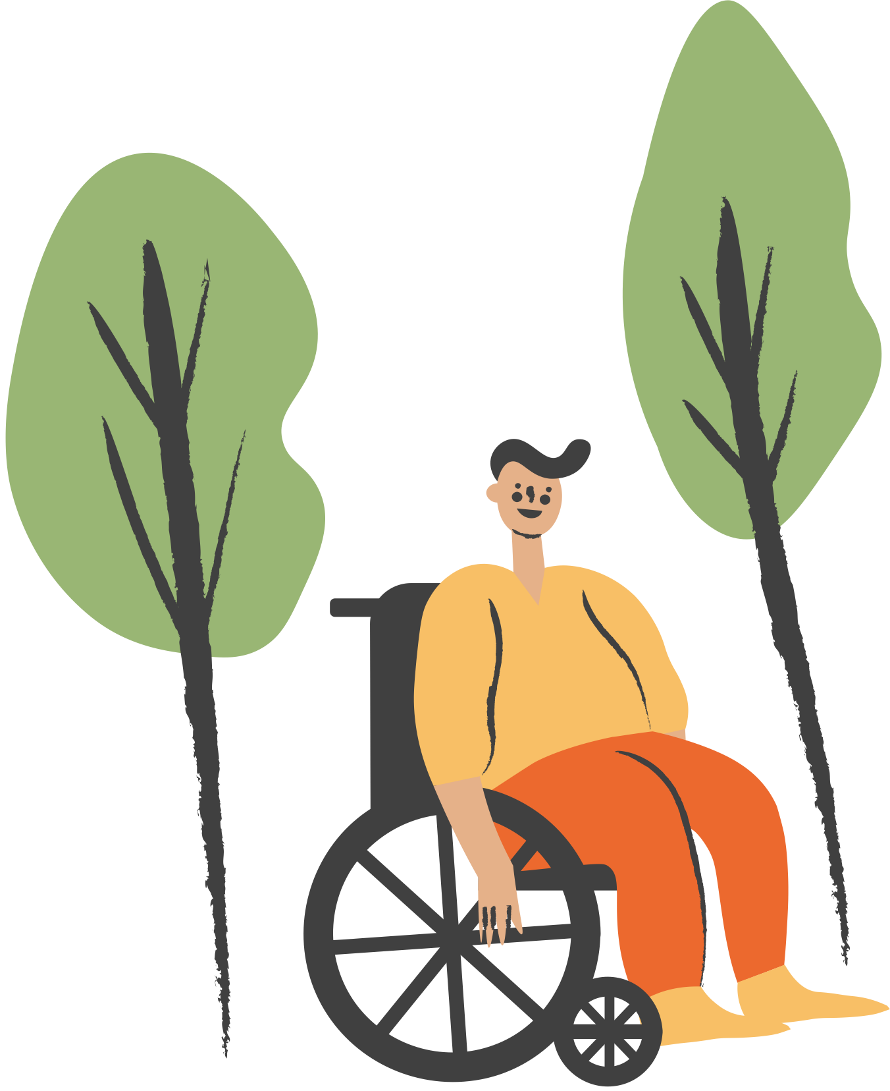
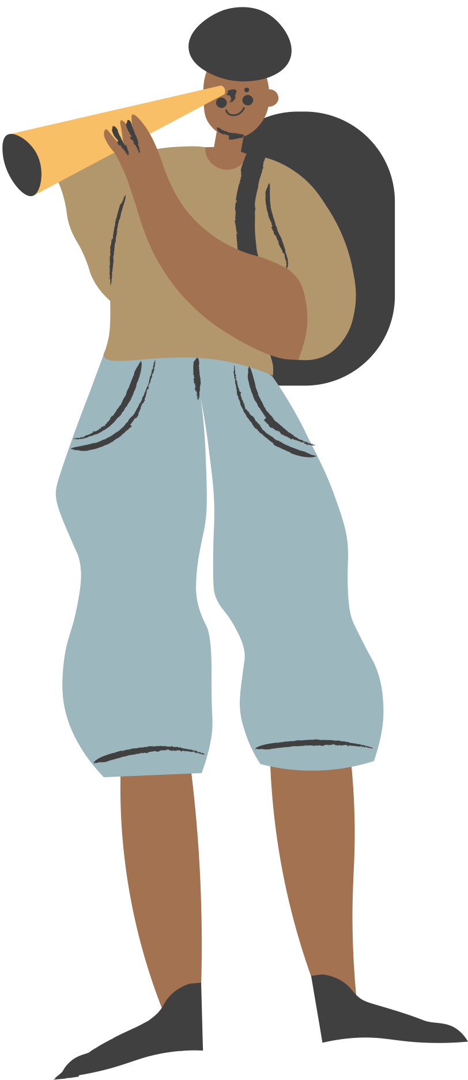

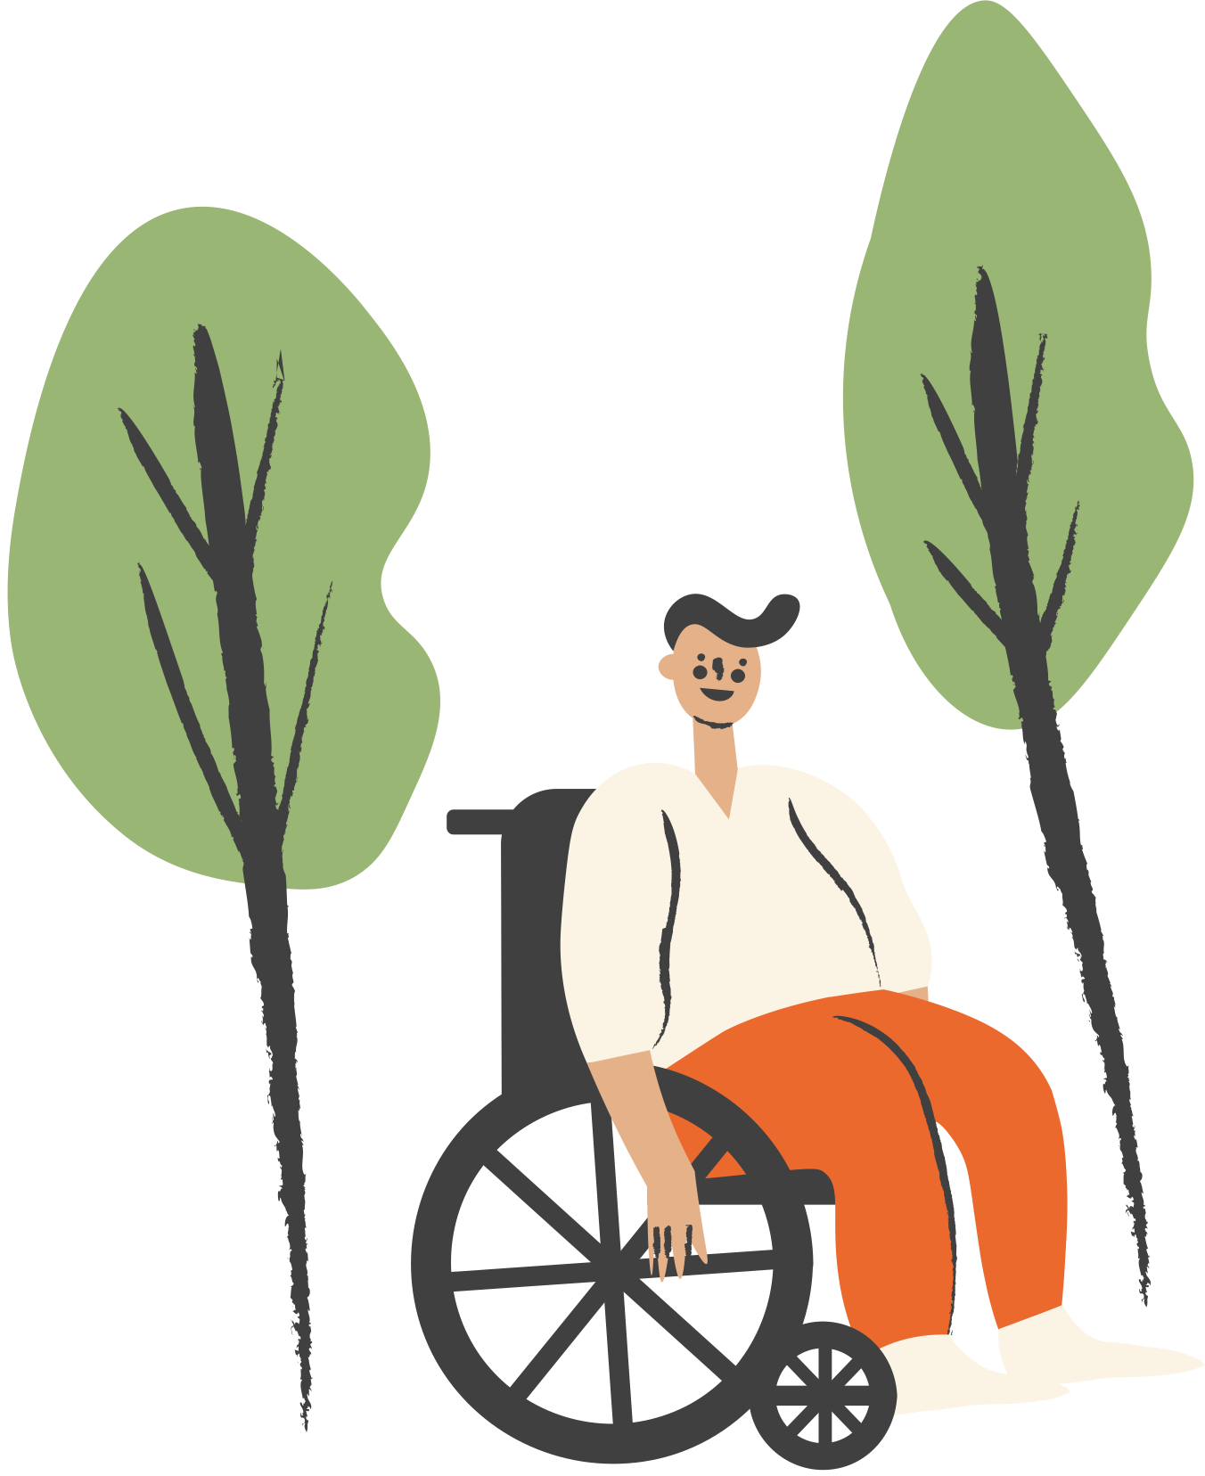
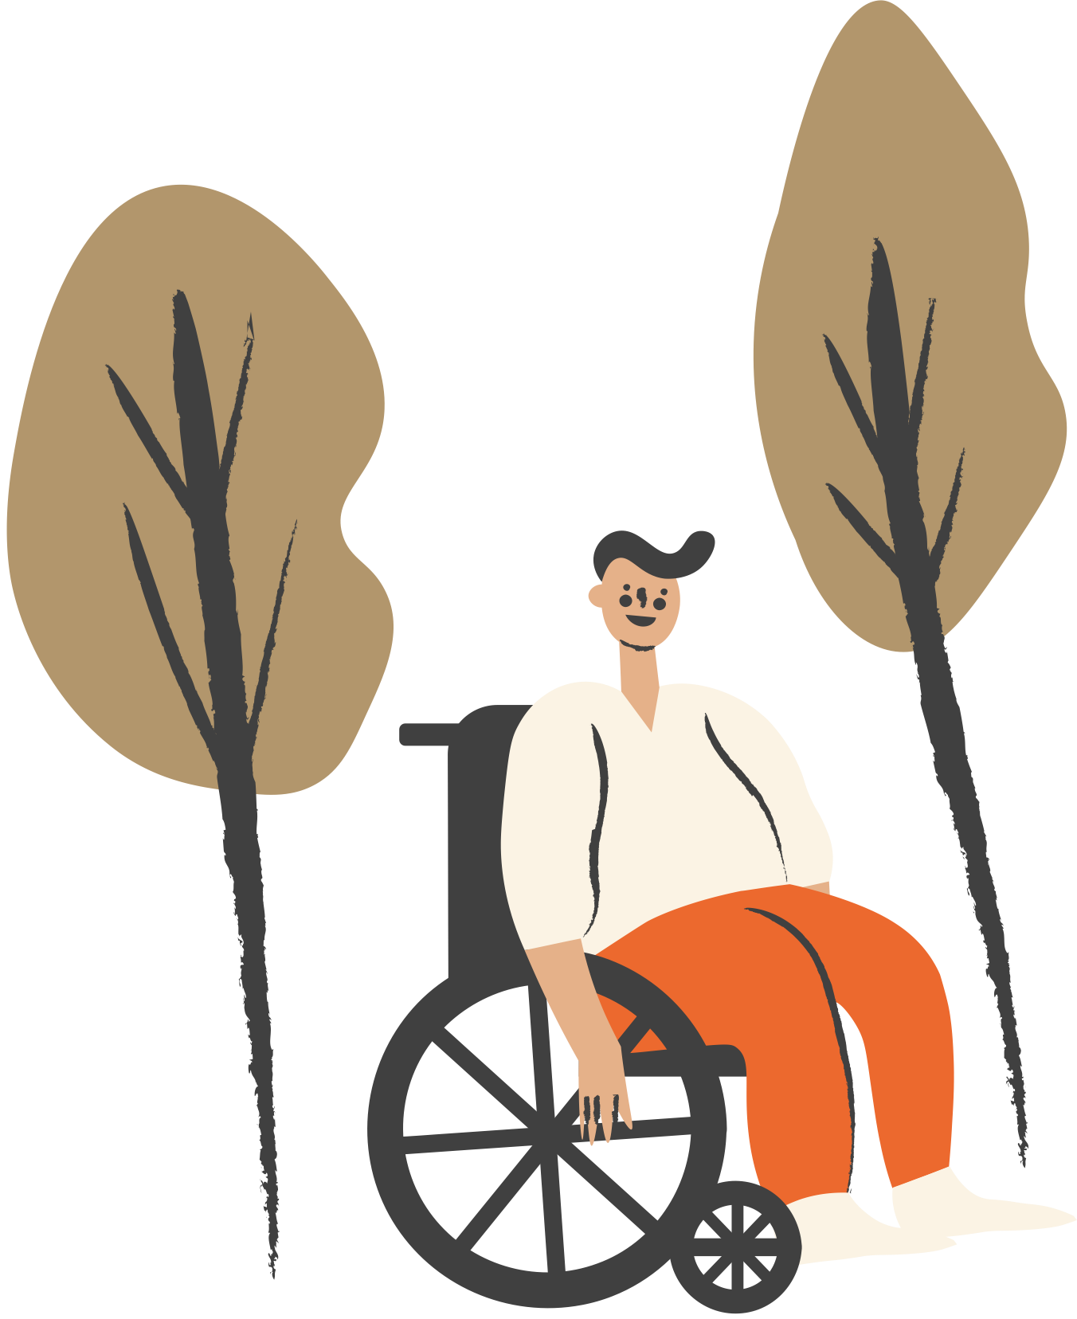



PERCEPTION INTERVENTIONS
Week 3
Notes:
Designed and created by Dandi Yang. Do not duplicate or upload with the express written permission of the author.

Slide 2

Notes:
Before we begin, please feel free to open up this video, keep in the background and and enjoy some chill, lo-fi beats as you navigate through this lecture. Or watch the video in between work sessions to destress and refocus.

Slide 3
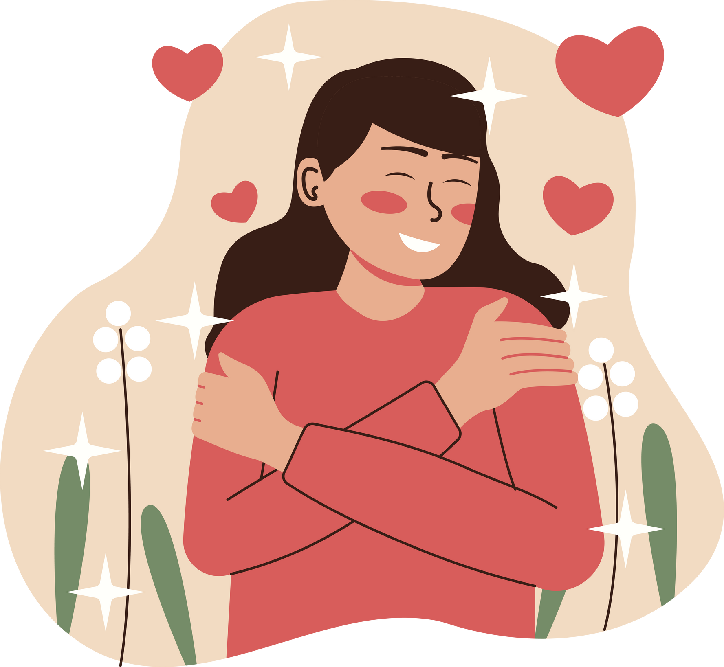
OVERVIEW
Mind/Body Connection
Stress Perceptions
Optimism and Health
Self-Esteem
Locus of Control
Anxiety Management
Coping Techniques

Slide 4


MIND/BODY CONNECTION
Previously, we learned about the science of stress
Your mind and emotions are just as important as your body
Studies have found that psychologically healthy people develop awareness and control of their thoughts and feelings
Individuals who are chronically pessimistic, angry, anxious, or depressed are more susceptible to stress and illness, including heart disease and cancer.
Notes:
In the previous class we talked about the science of stress. Yet, what is going on with your mind and emotions is at least as, if not more important than, what is happening in your body. In fact, what is going on in your mind determines what is happening in your body. Recently, researchers have been studying the mind–body connection to understand how thoughts and emotions relate to our experience with stress.

Slide 5
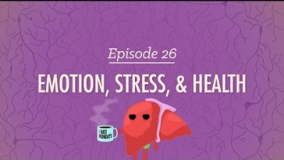
Notes:
https://youtu.be/4KbSRXP0wik
Stress, emotions, and their overall impact on our health.

Slide 6
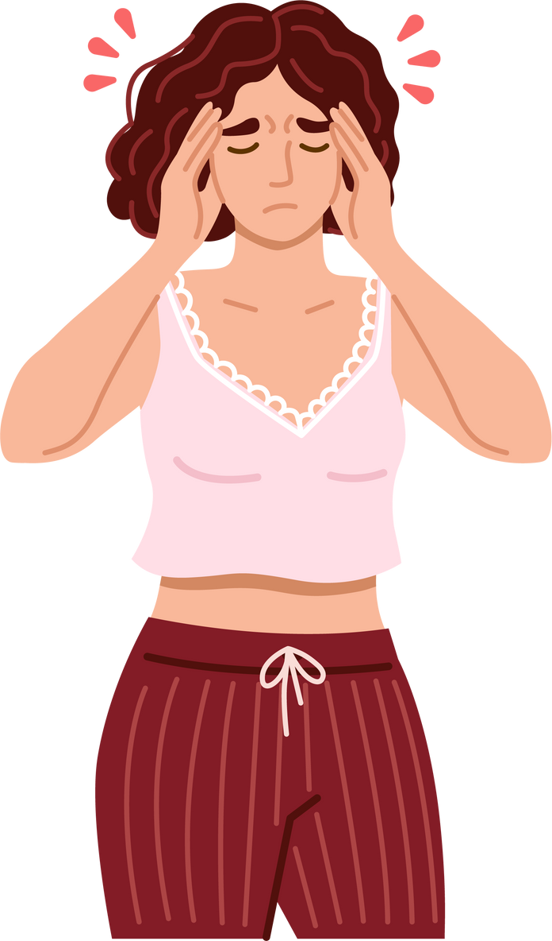
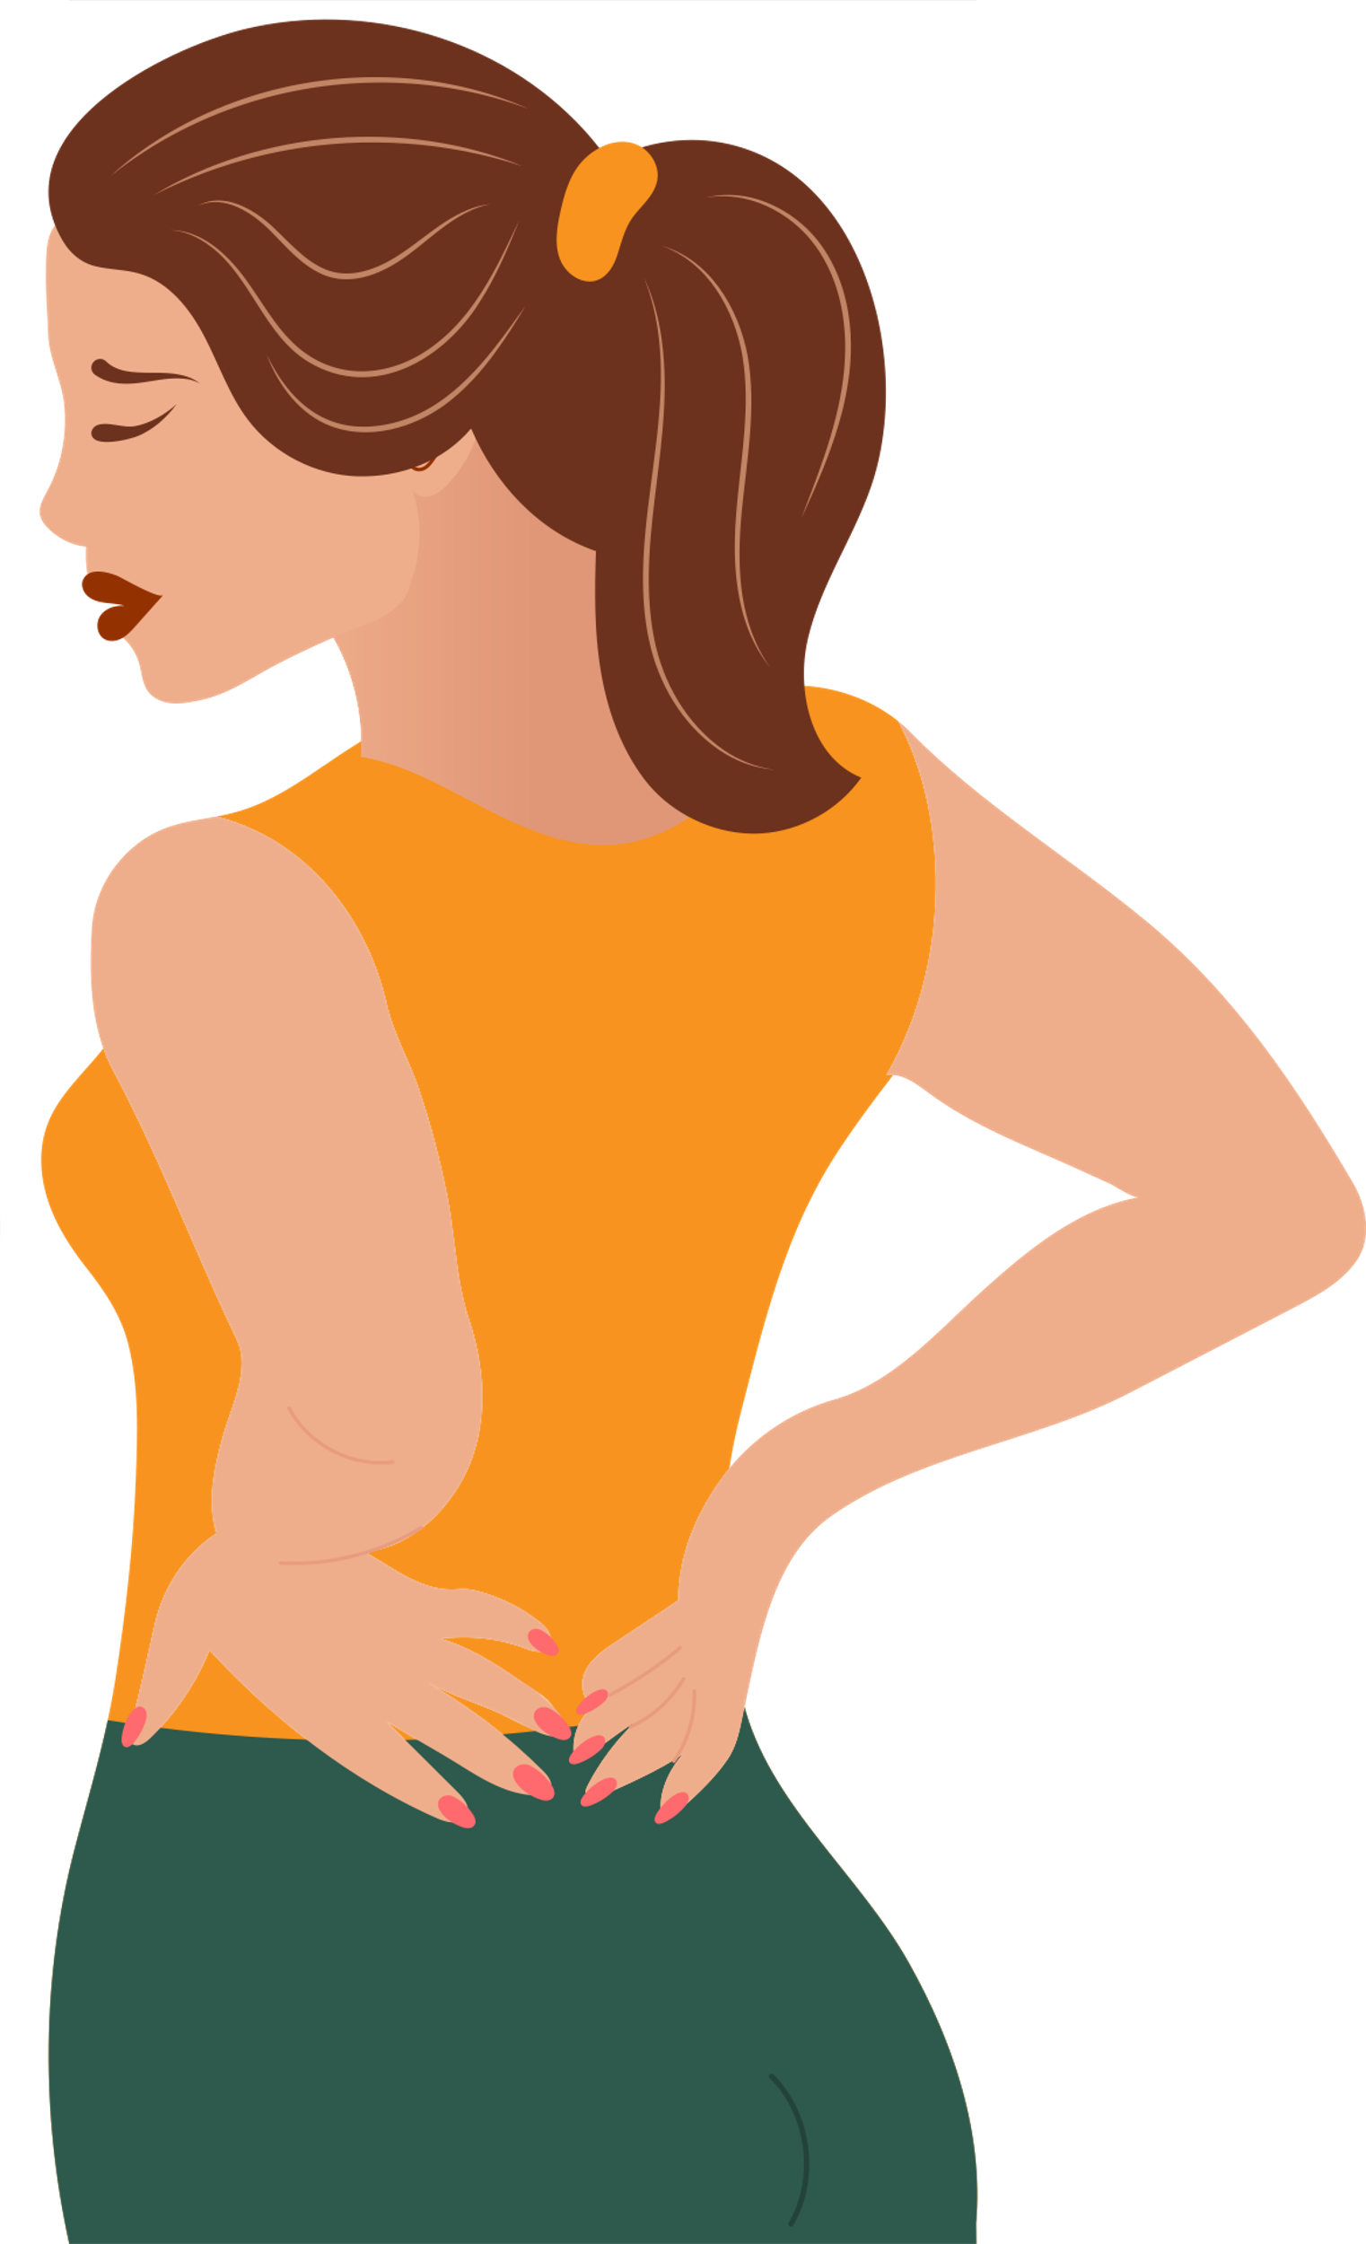
PSYCHOSOMATIC DISEASE
Have both a mind and a body component.
Stress can contribute to disease by weakening the immune system
Stress can also manifest as physically:
Digestive issues
Dizziness or shaking
Headaches
Muscle aches and pain
Racing heart
Elevated blood pressure
Notes:
In a psychosomatic illness, emotional stress or other psychological problems play key roles in the course of the physical signs and symptoms. For example, depression can contribute to psychosomatic illness, especially when the body’s immune system has been weakened by severe or chronic stress.
A common misconception is that a psychosomatic disorder is imaginary or "all in the head." In reality, psychosomatic symptoms are real and require treatment, just as any other illness.

Slide 7
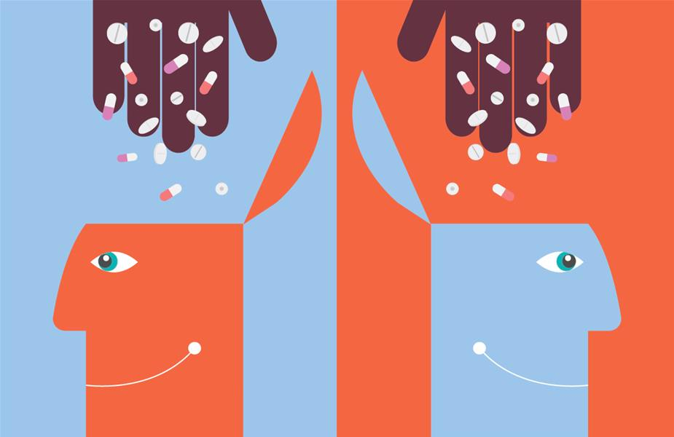
PLACEBO EFFECT
A placebo is a substance or treatment which is designed to have no therapeutic value
In study after study, across a broad range of medical conditions, 25-35% of patients consistently experience satisfactory relief when placebos are used instead of regular medicines or procedures.
Belief that a treatment works can, in fact, result in increased effectiveness.
Notes:
Nocebo effect is said to occur when negative expectations of the patient regarding a treatment cause the treatment to have a more negative effect than it otherwise would have. For example, when people who are susceptible to poison ivy are exposed to a harmless look-alike plant and told it is the real thing, they can develop a rash.
Epigenetics - changes in gene expression due to the environment (ie. what you eat, where you live, who you see, how you exercise, etc.). Certain experiences can activate genes or cause them to become dormant (including genes that are responsible for hereditary illnesses).

Slide 8
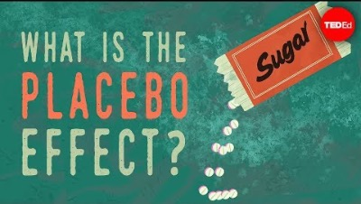
Notes:
https://youtu.be/z03FQGlGgo0

Slide 9
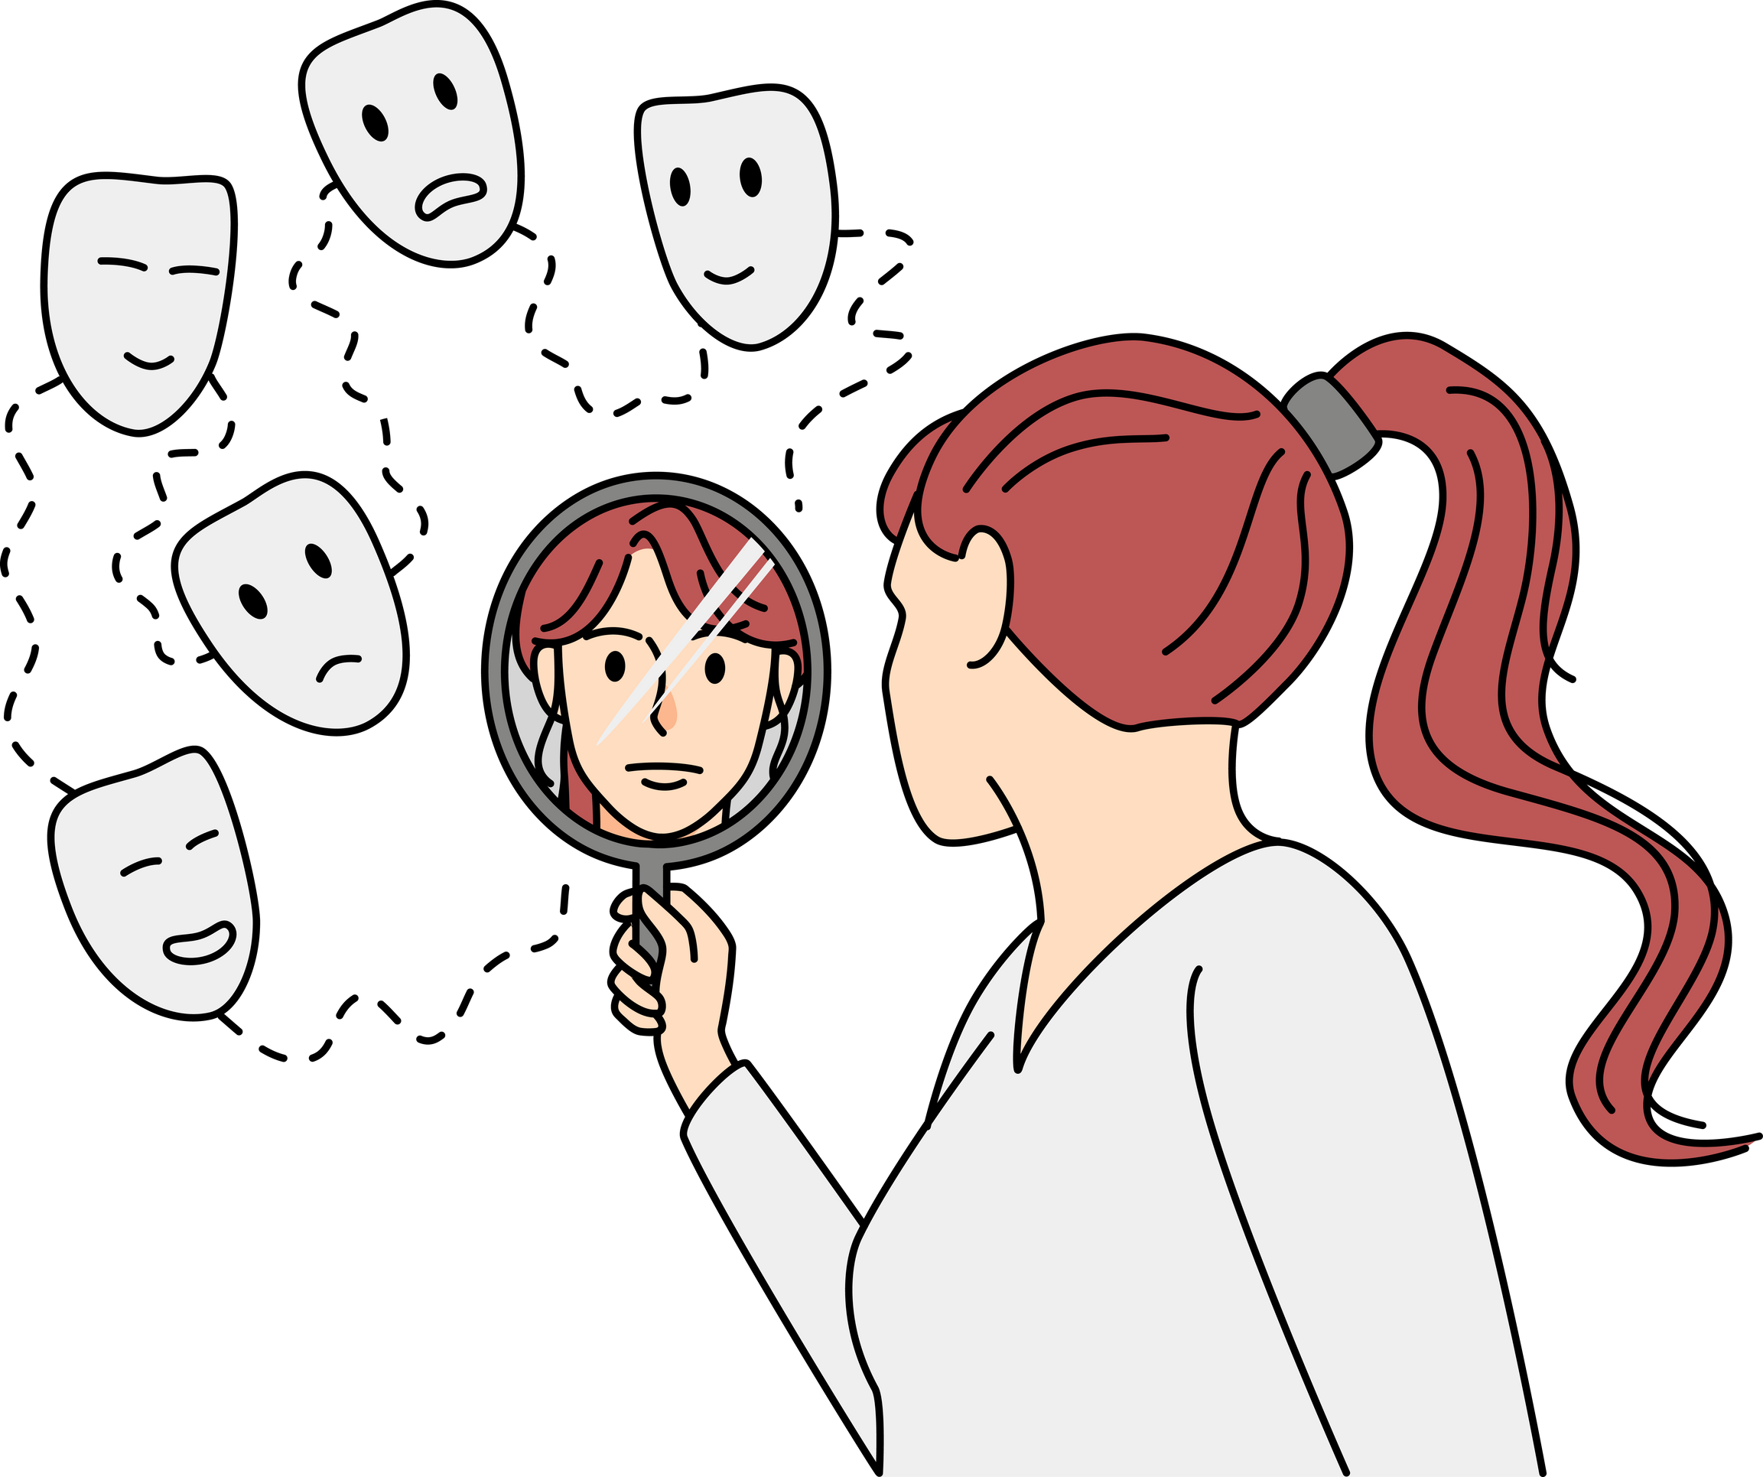
PERCEPTIONS
Cognitive interpretations of people, things, and events within your world
Self-worth also tied to perceptions
The most critical aspect in preventing unnecessary and unhealthy stress
Stress is affected by how you perceive it (more humourous than threatening?)
Notes:
The most critical aspect in preventing unnecessary and unhealthy stress is changing a person's cognitive (mental) interpretation of events, also known as their perception. Because we are very rarely placed in a truly threatening situation, in nearly all cases, it is the perception of the event, not the event itself, that causes stress. You might ask yourself, why do certain events cause some people stress, while others are not bothered by them at all? This is because of differences in how we perceive those events.

Slide 10
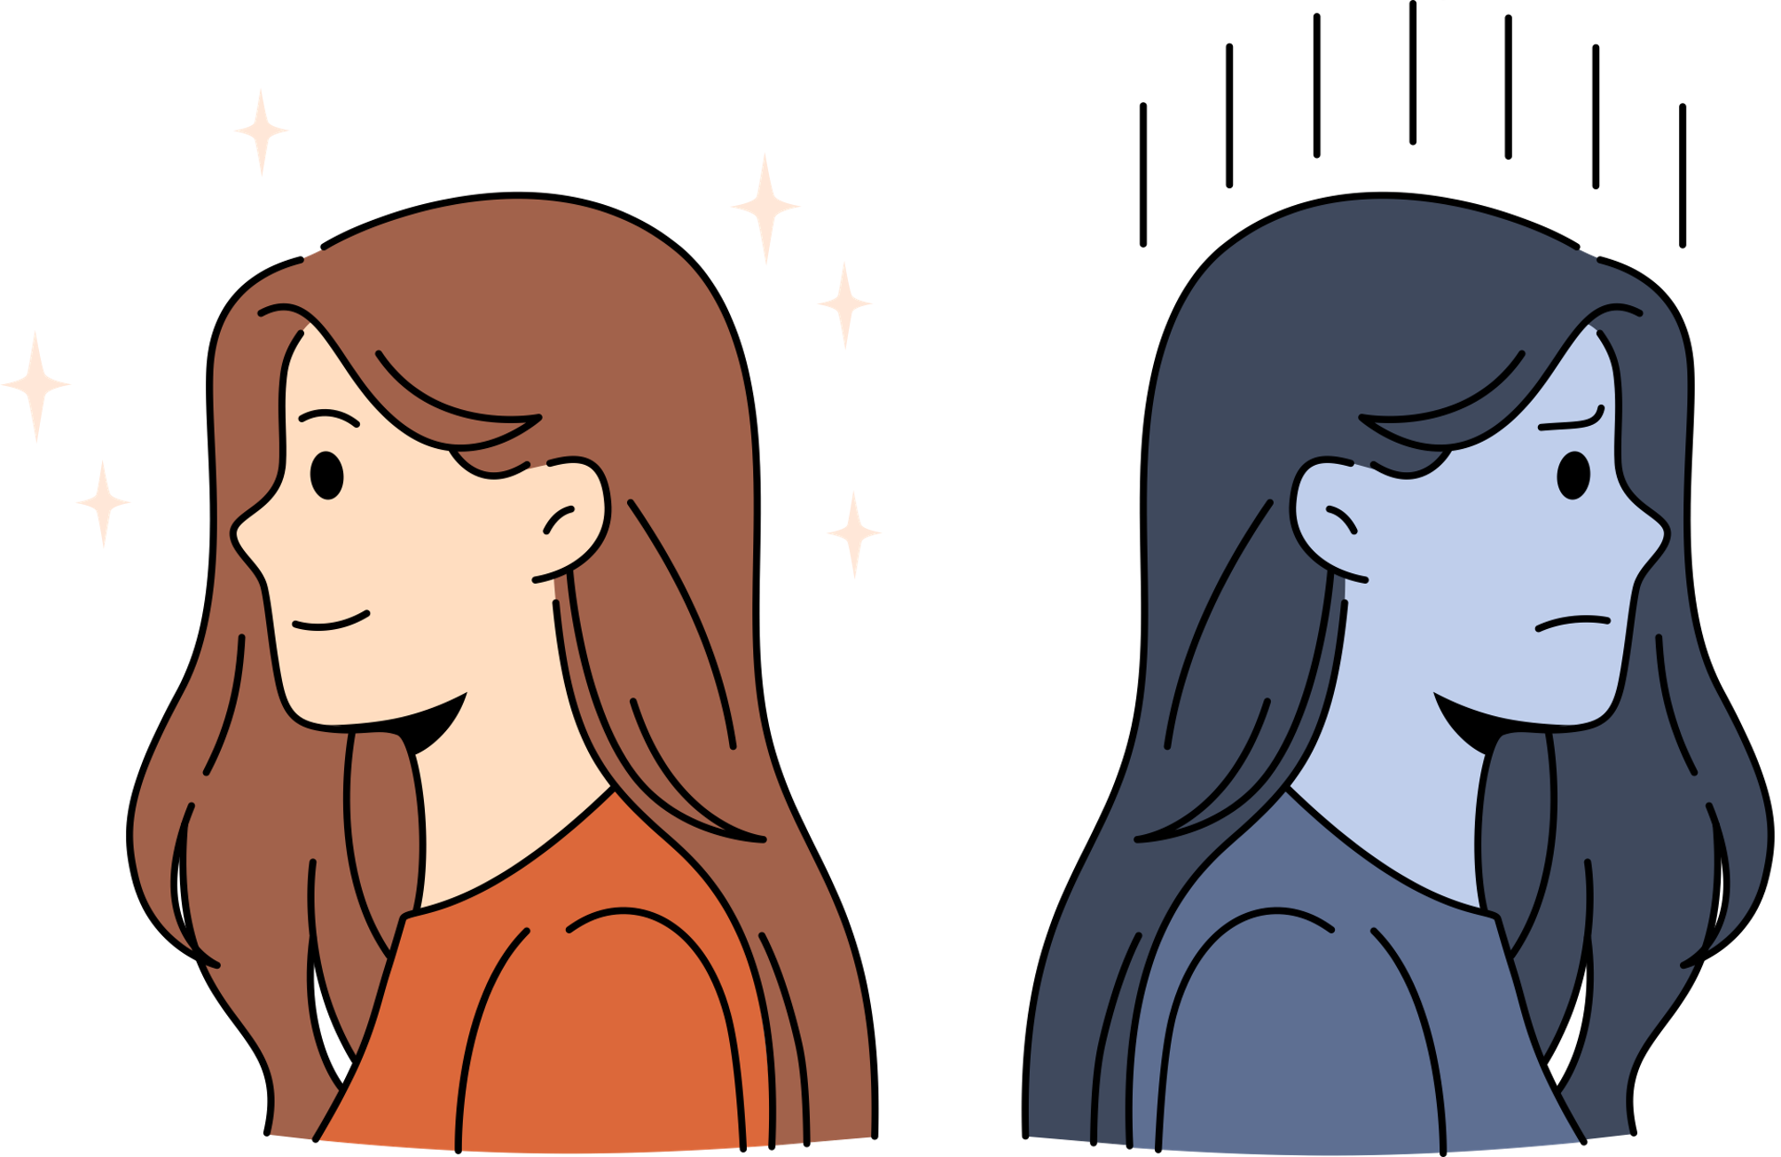
PERCEPTIONS
No event in life:
Is inherently stressful
Causes stress universally for everyone
We make stressful interpretations of events
Some aspect of the situation will inflict pain or discomfort
There will be a threat to our sense of well-being and comfort
Notes:
Some people might feel angry and stressed out at a long line. But is it something that is in their control? Will anger reduce the number of people who are lining up to go in? Another reaction might be that, we can listen to some music, read and interesting article on their phone, or come back at a less busy time.

Slide 11
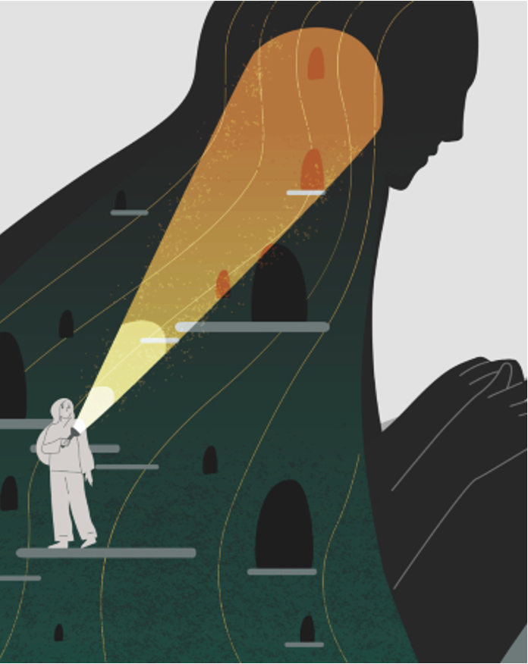
SELECTIVE AWARENESS
Being selectively aware of the positive aspect of each situation
People should realize the good and bad sides of every situation
Should selectively de-emphasize the disturbing features of a stressor
Should believe in their strengths and let go of their weaknesses
Notes:
When you are complimented- do you get embarrassed instead of being happy and appreciate of the compliment?

Slide 12
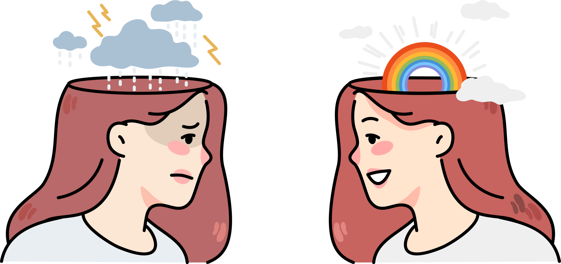
SELECTIVE AWARENESS
Realize that there is both good and bad in every situation but focus on the positive
De-emphasize (but do not deny) negative features
Recall the good events of each day
Develop an “attitude of gratitude”
Focus on things about which to be grateful
Notes:
There are going to be situations that you won’t like, some things you can’t control (the weather, a late bus), some things you can- regardless, you can do something about your perception. Instead of being mad about how cold it is outside, think of it as an excuse to stay inside and drink hot chocolate!
Focus on the positive and de-emphasize the negative (ex. an embarrassing memory-friends had a good laugh, good story to tell).
Pay more attention to the good things around you.
Positive aspects: Instead of being sad that you are in a hospital, perhaps the experience made you realize you want to be a doctor.
Learn to appreciate what you have- ex. a parent can be grateful of the extra time that they got to spend with their child who has cancer because of the current treatment options that we have.

Slide 13
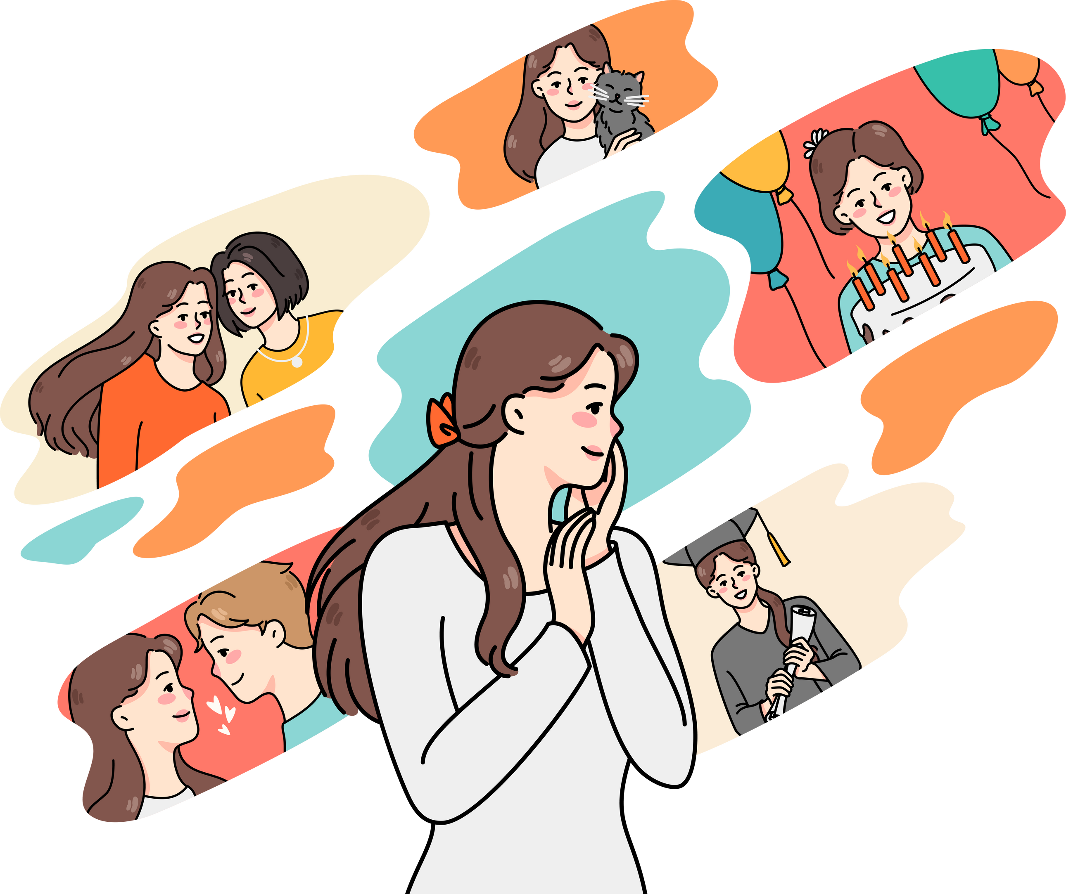
DAILY EXPERIENCES
People restrict themselves from enjoying the pleasures of life
People tend to follow a daily routine are desensitized to their experiences due to habituation
Ex. Walking the same route to school and not noticing the beautiful scenery around them
Notes:
When you are complimented- do you get embarrassed instead of being happy and appreciate of the compliment?

Slide 14
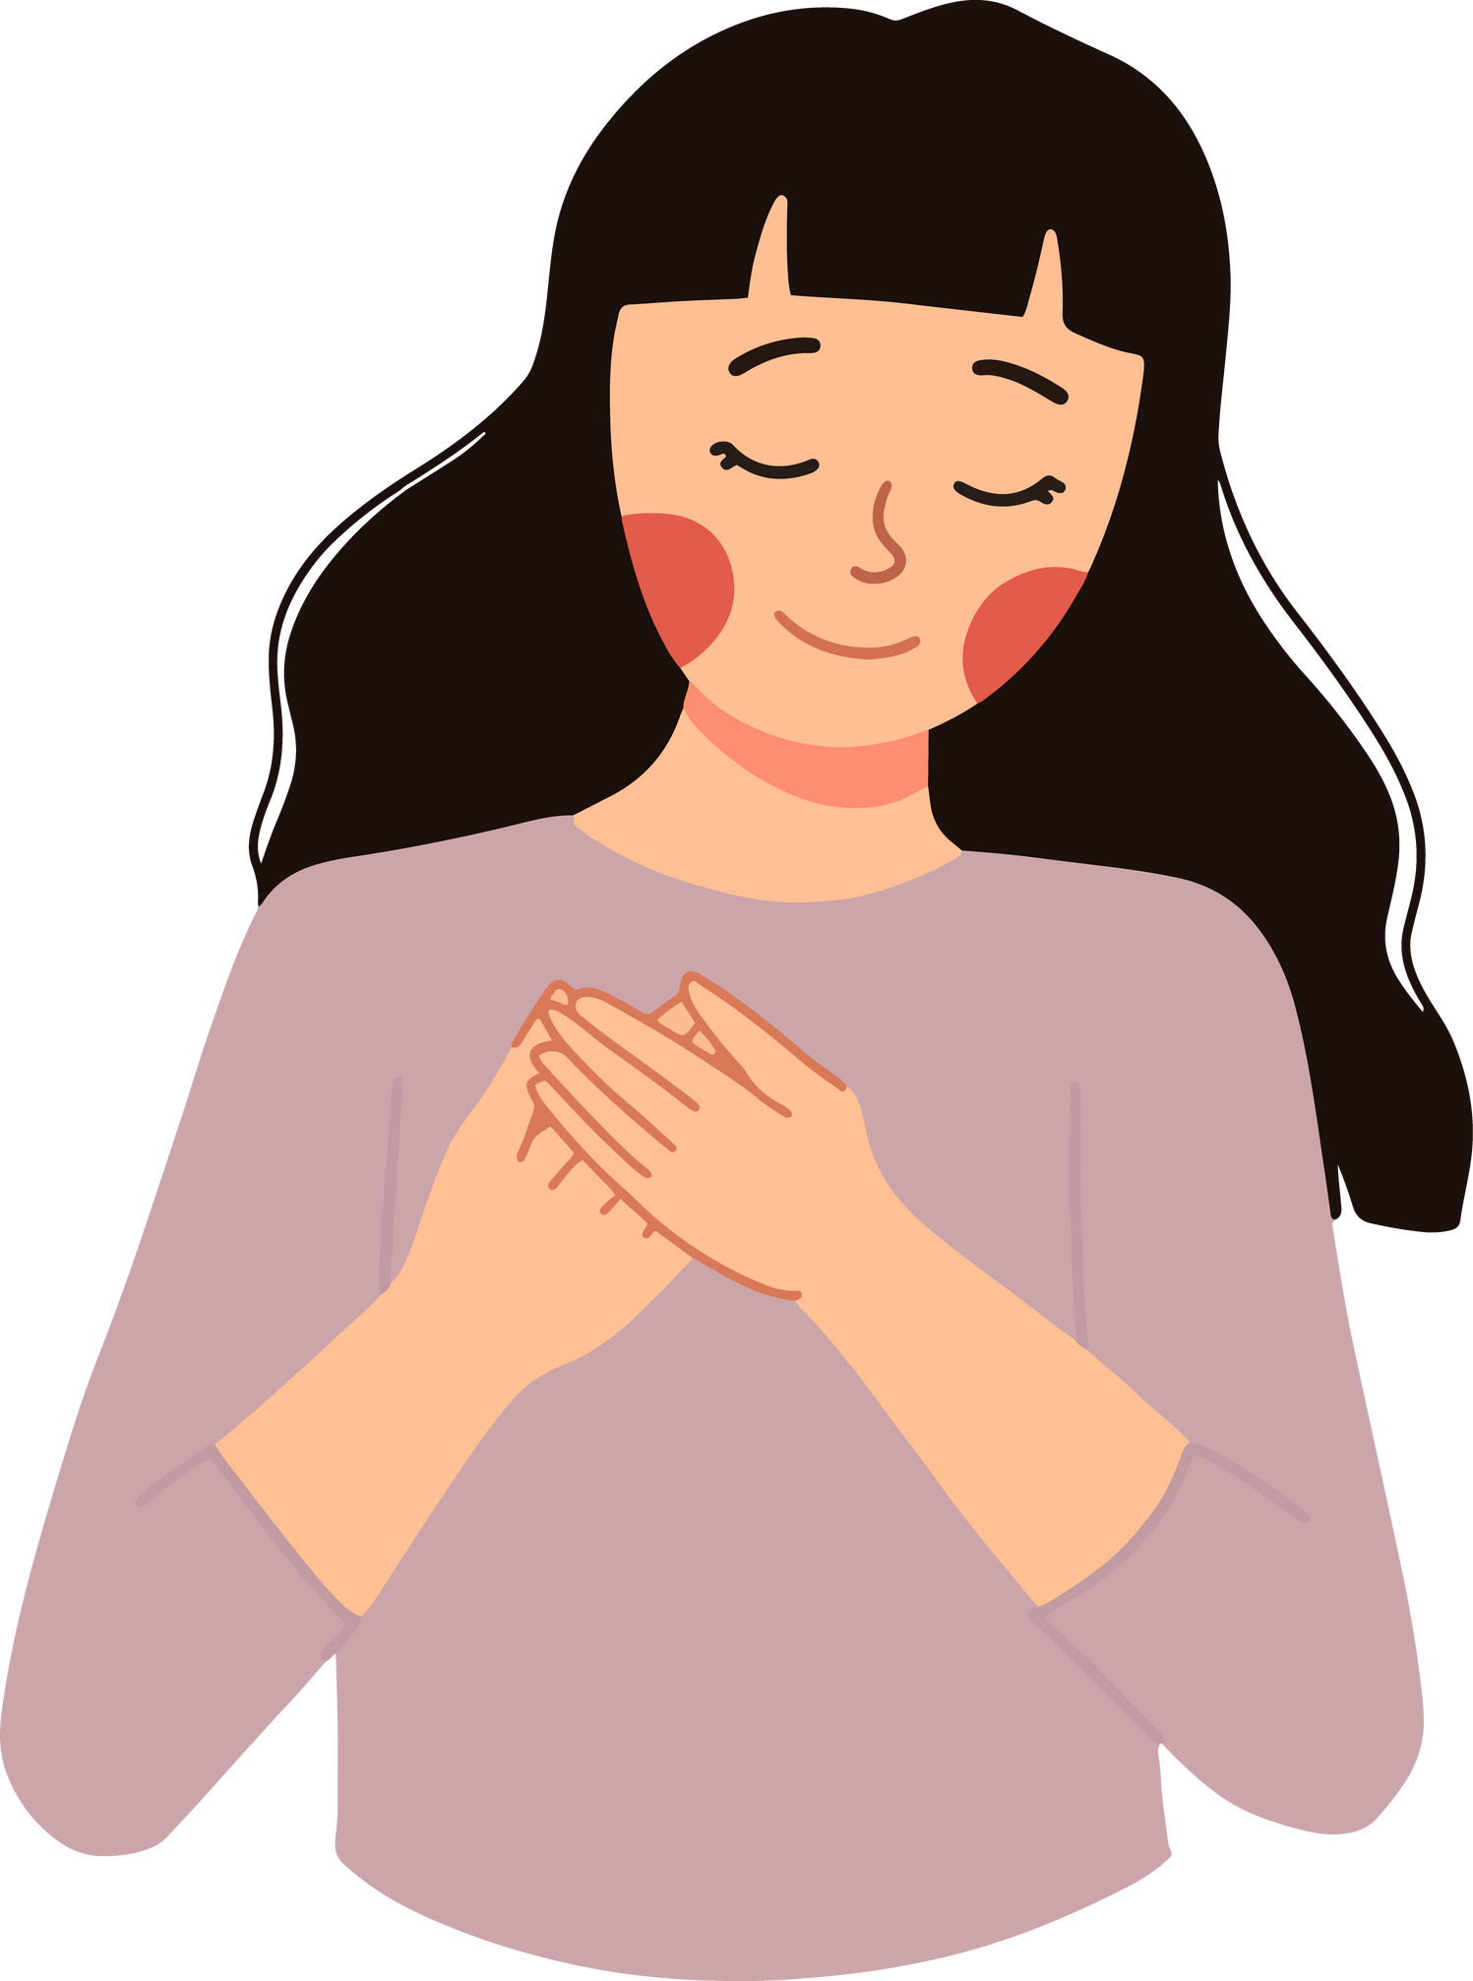
GRATITUDE EXERCISES
Gratitude Journal
Every evening, spend a few minutes writing down some good things about your day.
Give Thanks
Keep your eyes open throughout the day for reasons to say “thank you.” Make a conscious effort to notice when people do good things.
Gratitude Conversation
With another person, take turns listing 3 things you were grateful for throughout the day. Spend a moment discussing and contemplating each point
Notes:
Gratitude means appreciating the good things in life, no matter how big or small. Making the practice of gratitude a regular part of your day can build happiness, self-esteem, and provide other health benefits.

Slide 15

OPTIMISM AND HEALTH
Being an optimist can keep you healthy, and being a pessimist can contribute to poor health
A 2009 study of 97,000 women showed that the more optimistic people were, the lower their rates of mortality for all illnesses
Notes:
Another explanation is behavioral. It is possible that optimists enjoy better health and longer lives than pessimists because they lead healthier lifestyles, build stronger social support networks, and get better medical care. Indeed, some studies report that optimists are more likely to exercise, less likely to smoke, more likely to live with a spouse, and more likely to follow medical advice than pessimists.
BLAMING THE VICTIM
In spite of our best efforts to manage stress and have a positive outlook on life, disease happens. The mentality that disease is the “fault” of the victim is not a productive approach to health. A more constructive approach to health is to acknowledge that how we think and feel does have an impact on our health, yet some disease and death are inevitable.

Slide 16
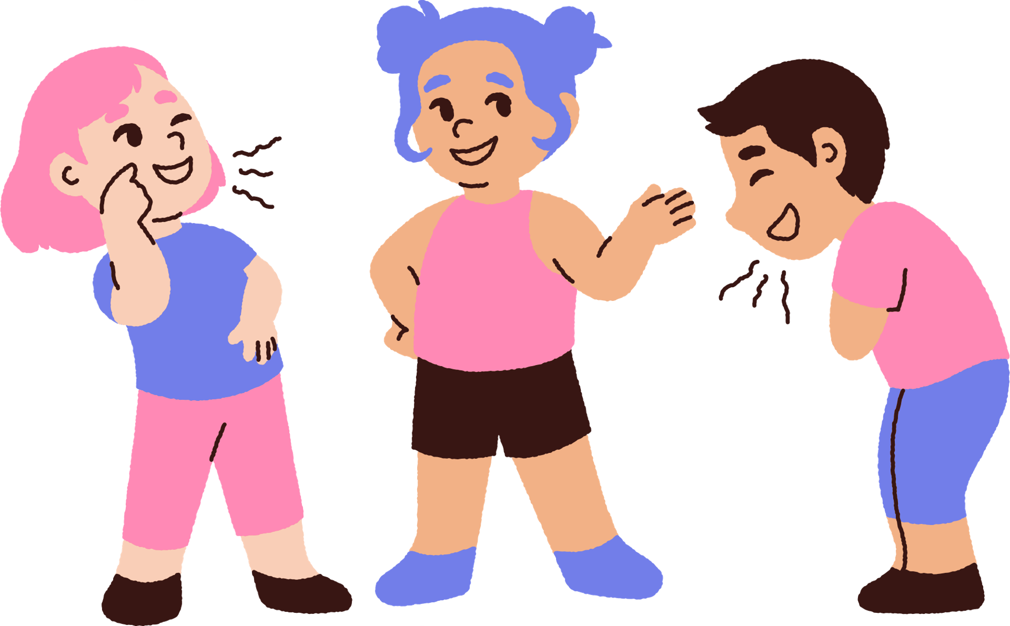
HUMOUR AND STRESS
Humour can be an effective means of coping with stress- increases cheerfulness
Humour prevents negative life events from resulting in mood disturbances
Coping with humour acts as a buffer between negative life events and mood disturbances
Notes:
Humour can be a great mechanism for dealing with stress. Jokes and witty conversation can make you feel closer to the people around you. In addition, a key element of jokes is that they force you to look at the same situation in different ways. Reappraising a difficult situation involves recognizing that it may have a hidden benefit or may not be as bad as it first appeared. People who used humour a lot were more likely to find new ways to think about the stressful situation, which was related to decreases in stress.
Humour and laughter: provides relieve from anxiety, stress, tension, outlet for anger, escape from reality, improve immune system, increase tolerance and pain.
However, negative forms of humour—particularly jokes that people make at their own expense—can backfire. These jokes can decrease social support and can make it harder for people to reappraise situations. Ultimately, these jokes may lead to higher levels of stress.

Slide 17
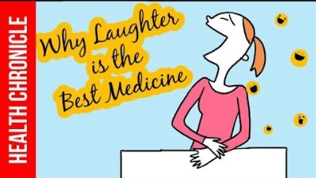
Notes:
https://youtu.be/DB_cSy0IIOg

Slide 18
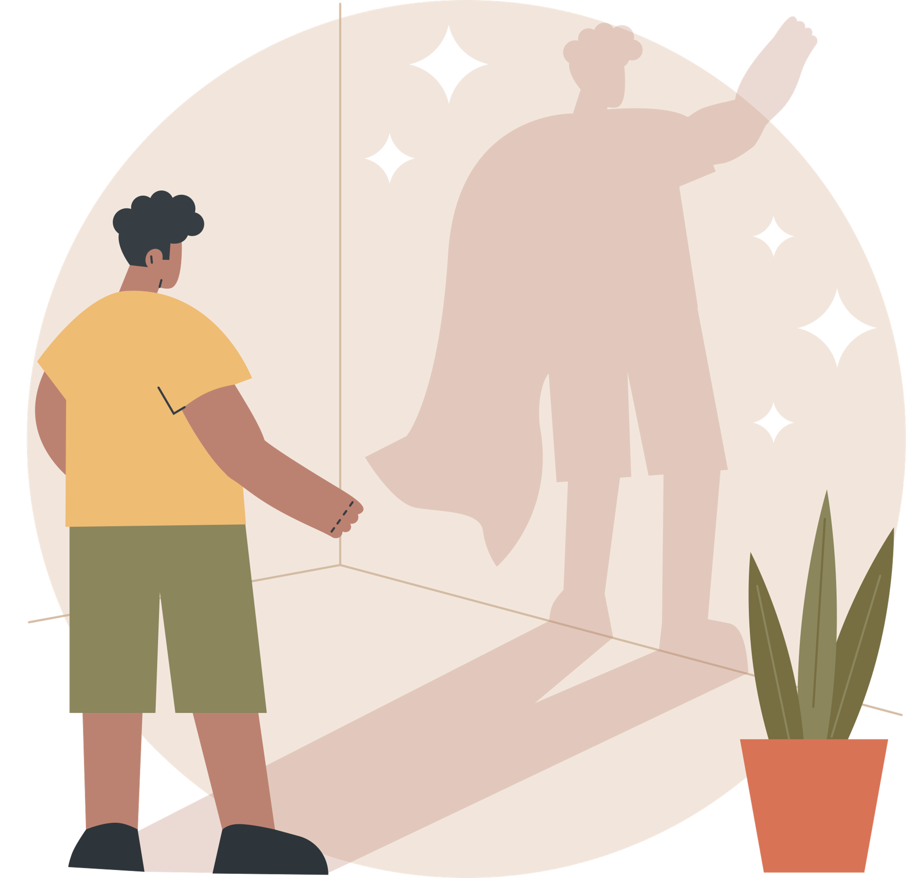
SELF-ESTEEM
Self-esteem is how you regard yourself
Can be affected by treatment by others; how we are judged affects how we feel about ourselves
Poor self-esteem is related to drug abuse, irresponsible sexual behaviour, and other unhealthy activities
Self-esteem is learned and can be re-learned
Stress management requires confidence in your ability to control your life effectively
Notes:
Evaluation of his or her own worth, beliefs about ones self
Self esteem is a predictor of certain outcomes, such as academic achievement, happiness, satisfaction in marriage and relationships, and criminal behaviour.
The way you feel about yourself, your self-esteem, impacts your happiness level and also can make life more or less stressful for you. For example, if you trust your ability to handle what comes, you will be more likely to see difficult situations as a challenge instead of as a threat; conversely, if you don’t trust your own ability to handle things, you will be more likely to see new situations as threatening and stress-provoking.
Self efficacy- belief that one can be successful at doing something

Slide 19
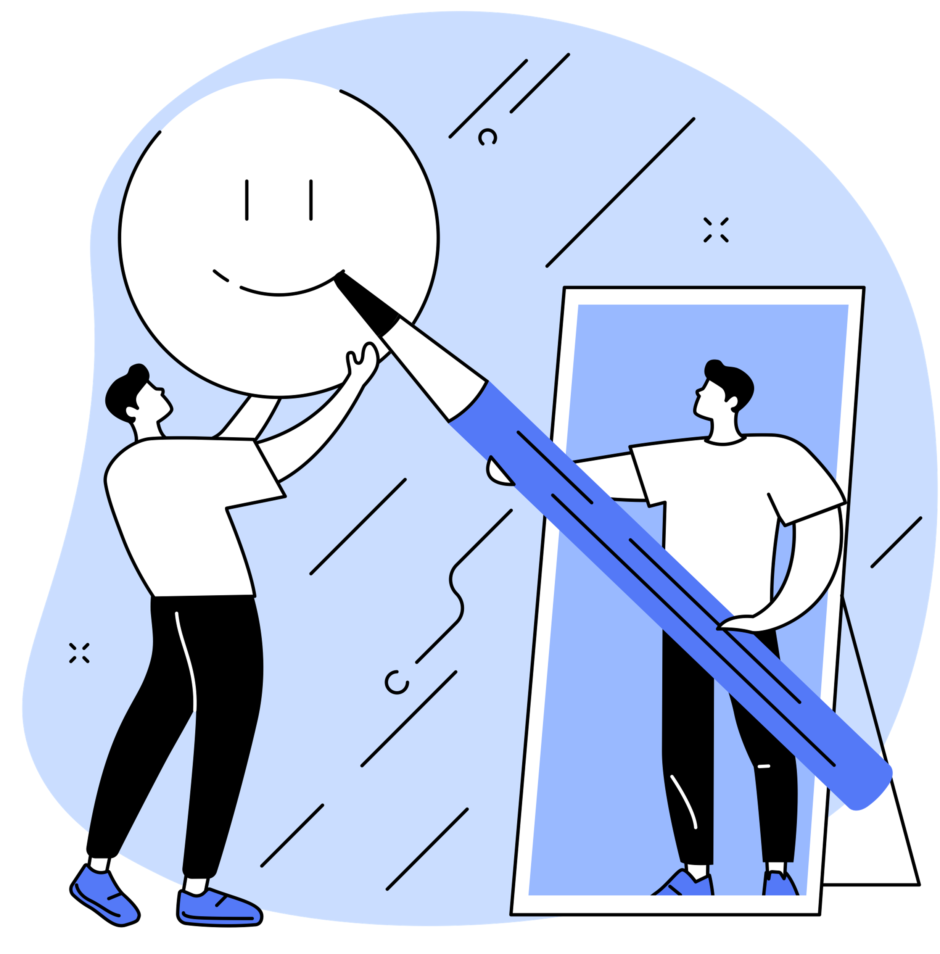
HOW TO INCREASE SELF-ESTEEM
Self-efficacy helps in building self-esteem
Belief that one can be successful at doing something
Helps in recovering from posttraumatic stress disorder, depression, and occupational stress
Notes:
Self-efficacy also determines what goals we choose to pursue, how we go about accomplishing those goals, and how we reflect upon our own performance.
People with a strong sense of self-efficacy:
Develop deeper interest in the activities in which they participate
Form a stronger sense of commitment to their interests and activities
Recover quickly from setbacks and disappointments
View challenging problems as tasks to be mastered

Slide 20
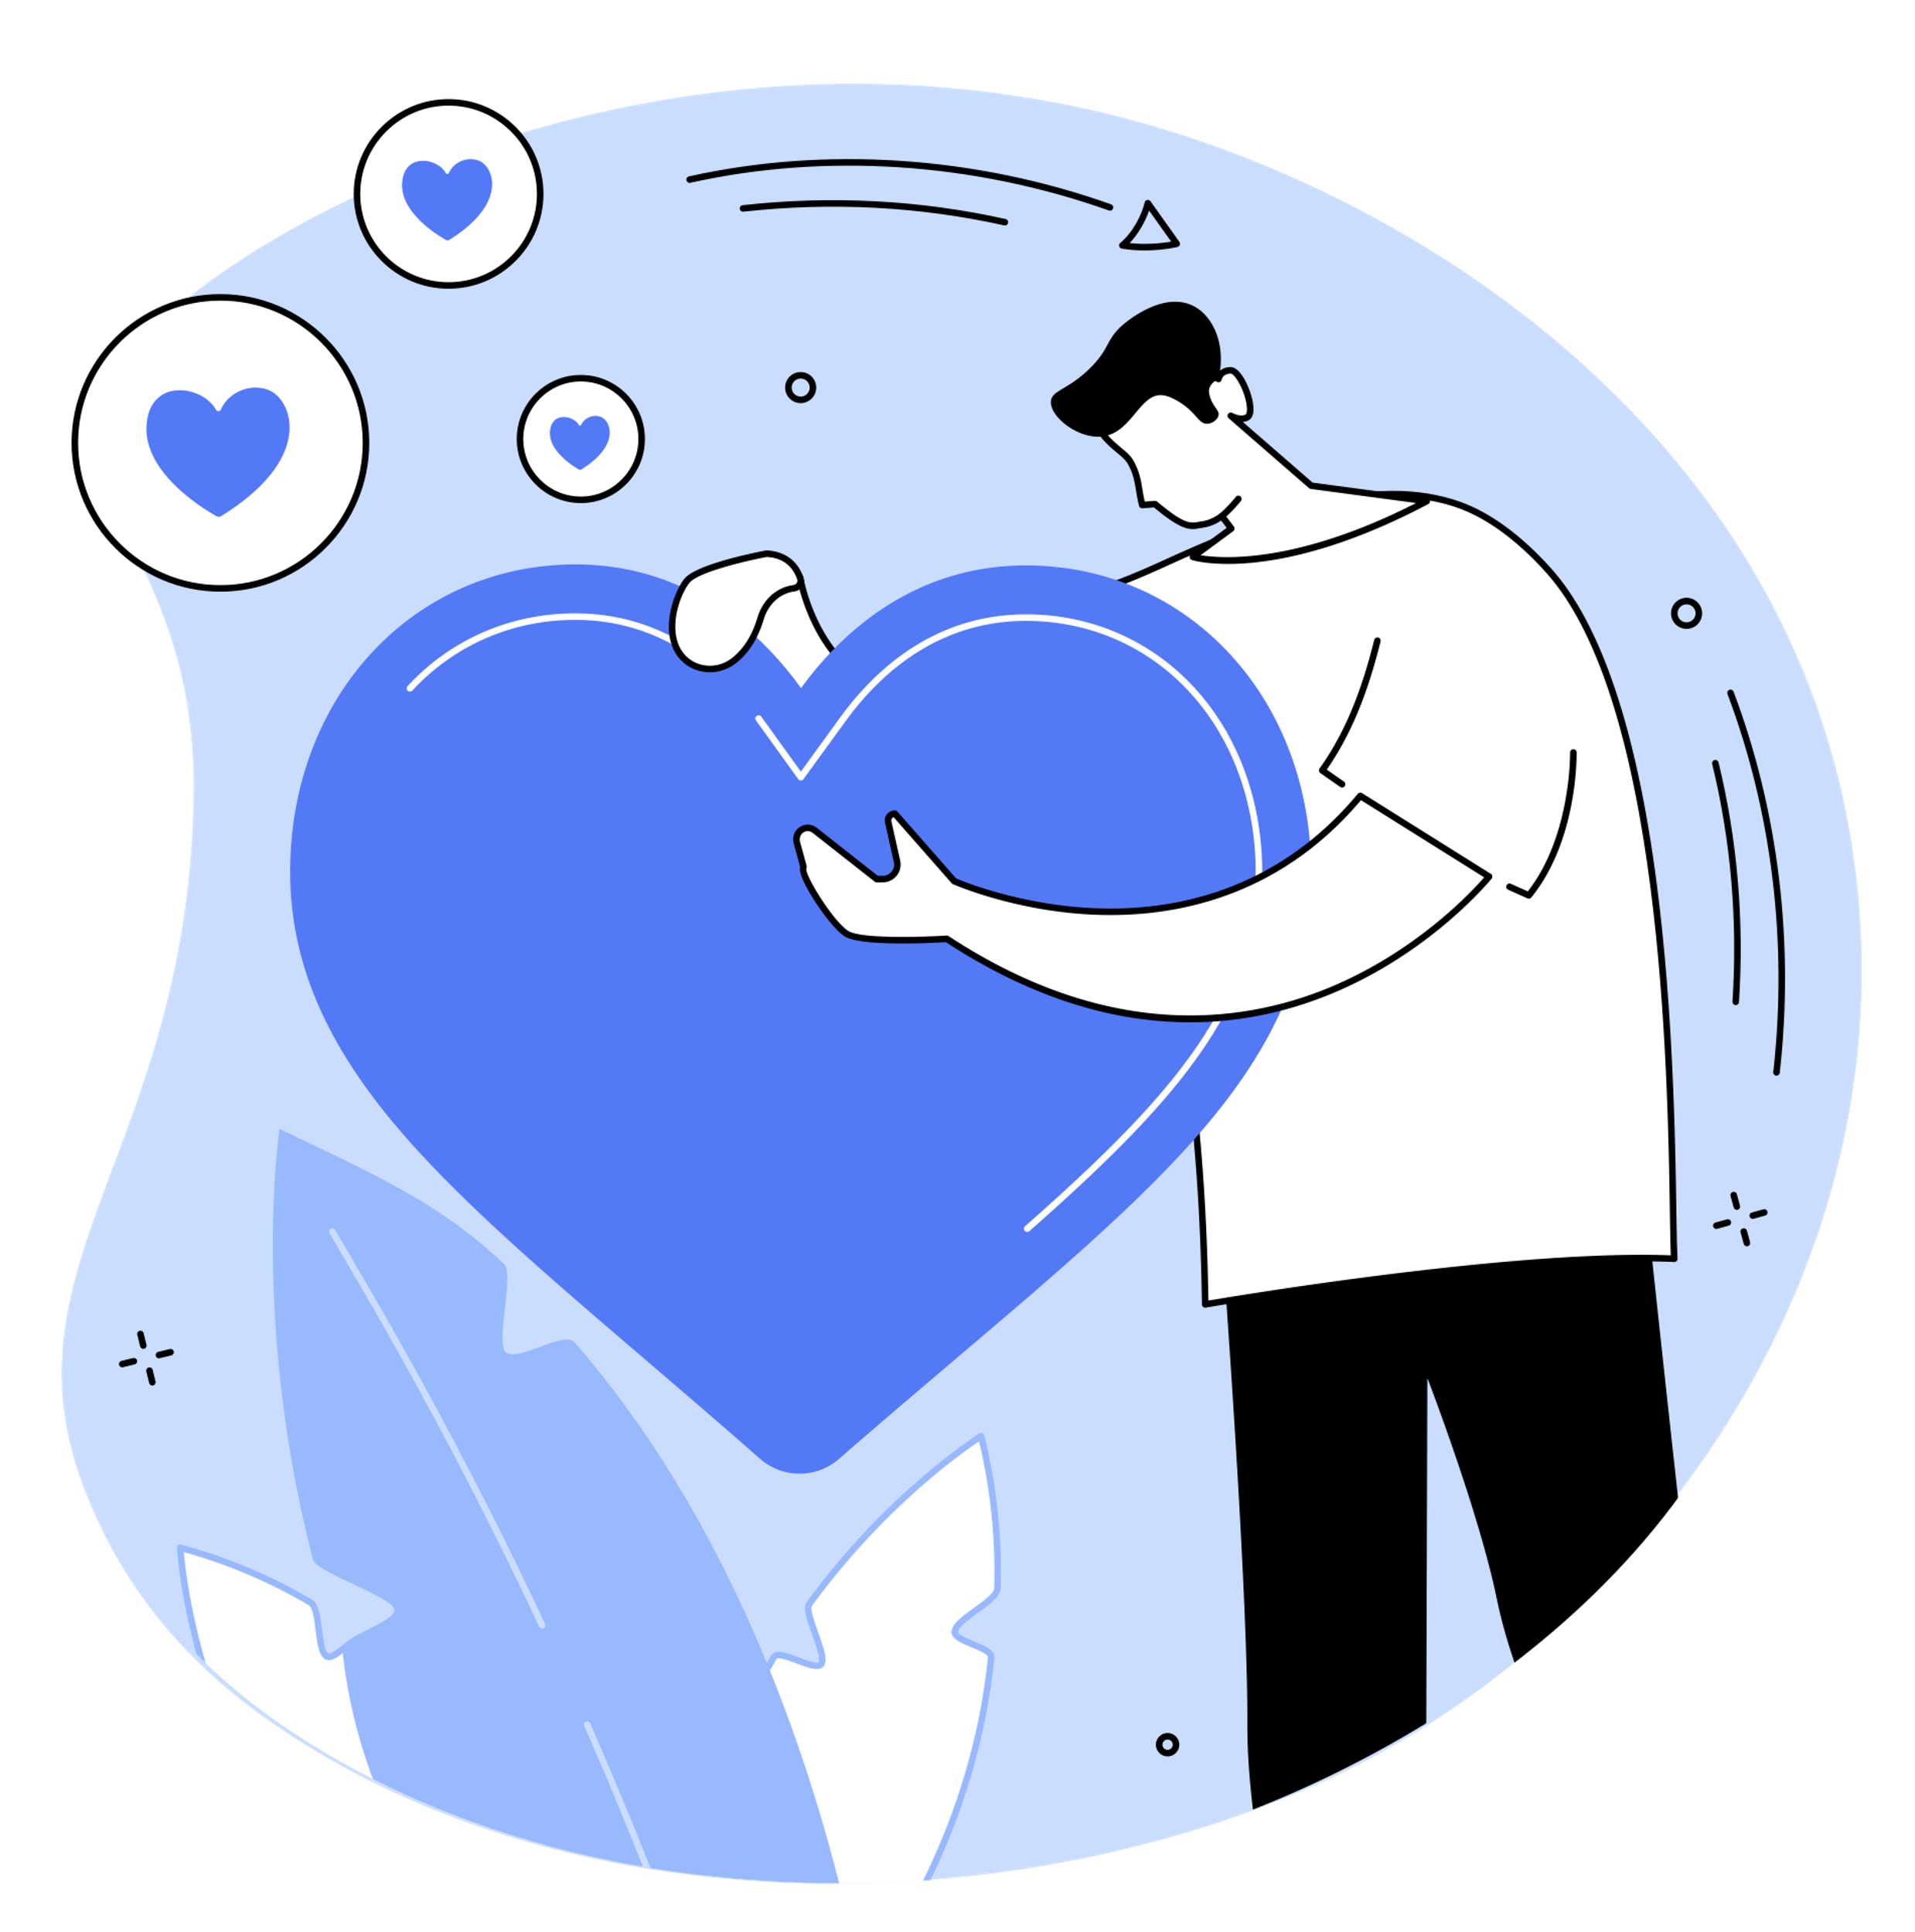
HOW TO INCREASE SELF-ESTEEM
Identifying what needs to be improved
Work on your optimism
Develop positive self-talk
Try new challenges
Stay away from negative people
Notes:
1) If you are able to develop the ability to see the glass as half-full, this can contribute to feelings of self-efficacy as well as overall happiness and peace of mind. Moreover, there are many proven benefits to optimism, so developing a greater sense of it, creating thinking habits that skew toward optimism, can provide these benefits for your health and general happiness.
2) One thing that has a major influence on a person’s self-esteem is their ‘self-talk’, the way they talk to themselves, interpret things, and comment on life inside their heads. A thinking style that is habitually negative can perpetuate a negative view of one’s life and self, as well as cause other problems. – journal writing, thought stopping, changing the language
3) Even simply becoming immersed in hobbies can help with self-esteem Learning what you are able to do well can provide you with a new view of yourself and a new level of self-respect.
Hobbies can also help you to relieve stress, so hobbies can provide a double-win.
4) We can all feel negative from time to time, but some friends can tear you down instead of building you up, and those people can wear away at your self-esteem more than you may realize. Learning to identify and create boundaries with those who drain us of our self-esteem can help. Identifying and cultivating relationships with more supportive friends can build us up immensely as well. Help yourself cultivate the social life you deserve.

Slide 21

LOCUS OF CONTROL
Perception of the amount of personal control you have over events in your life
External locus of control: perception that one has little control over these events
Internal locus of control: perception that one has a good deal of control over life events
Those with external locus take less action to control their lives because they believe such action is fruitless
Notes:
Locus of Control - There are generally two ways of seeing our level of control in any given situation, which ascribes our chances of future success or failure to either internal or external causes. Having an internal locus of control assumes we are responsible for the outcomes of our own actions. Having an external locus of control assumes whatever happens to us is unrelated to our own behaviour.
People can have good locus of control in one area of life and not in another - Maybe good at academics but you have a gambling addiction? You have the discipline to study and focus yourself on your school work, but cannot use that same discipline to stop yourself from gambling.

Slide 22
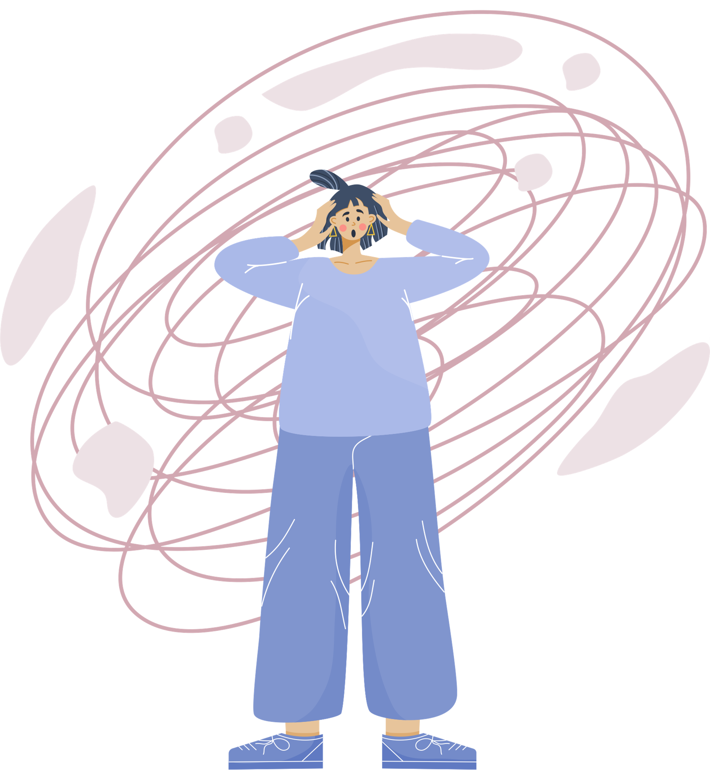
ANXIETY MANAGEMENT
Anxiety is unrealistic fear or a reaction to situations perceived as stressful or dangerous.
Body usually responds with increasing heart rate, blood pressure, breathing (similar to stress response)
Can be a reaction to stress
Notes:
Stress is a response to any demand placed on your brain or physical body. People can report feeling stressed when multiple competing demands are placed on them. The feeling of being stressed can be triggered by an event that makes you feel frustrated or nervous. It can be a reaction to stress, or it can occur in people who are unable to identify significant stressors in their life. To be anxious, you must feel fear, your body in responding (heart rate up, blood pressure, breathing hard) and you must want to escape or avoid whatever is causing the anxiety.
Different from worry: worrying is feeling uneasy or being overly concerned about a situation or problem. You might worry about things like health, money, or family problems. Anxiety often manifests physically in the body while worry does not.
Worry: Suzy doesn’t like bees and it causes her some worry. When she sees a bee or hears one buzzing around her, she begins to feel stress. This worry prompts her to act and she moves away from the bee. But, once the bee is gone, her worry and stress go away.
Anxiety: Suzy’s fear of bees causes her to look for bees everywhere. When she sees them, her heart beats rapidly, she feels shortness of breath, and feelings of panic that she can’t control. This feeling continues after the bee is gone and may even impair her ability to function.

Slide 23
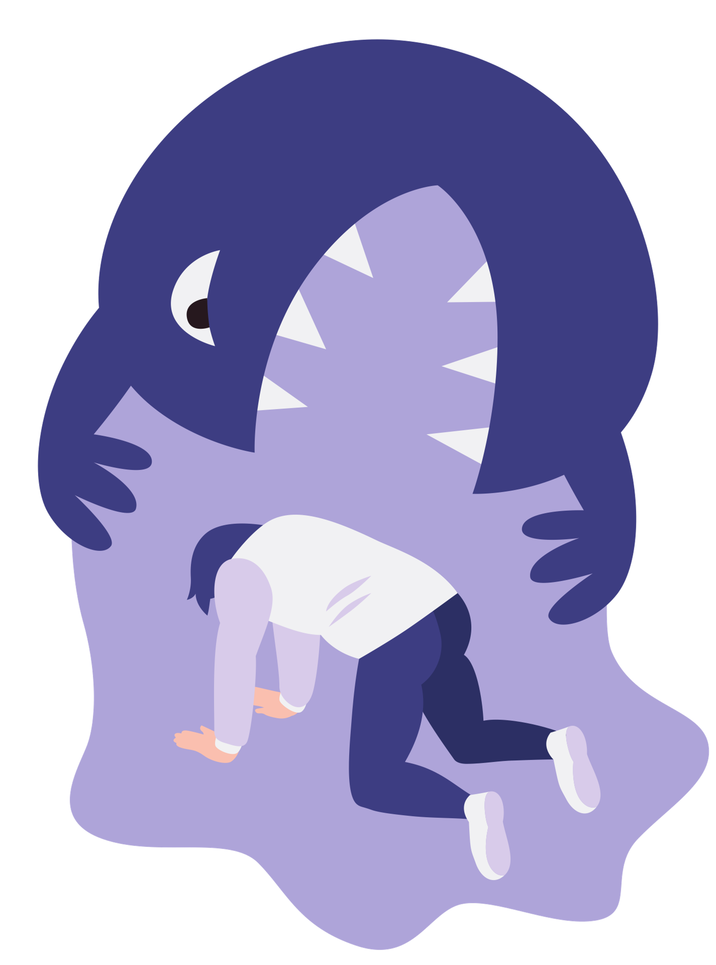
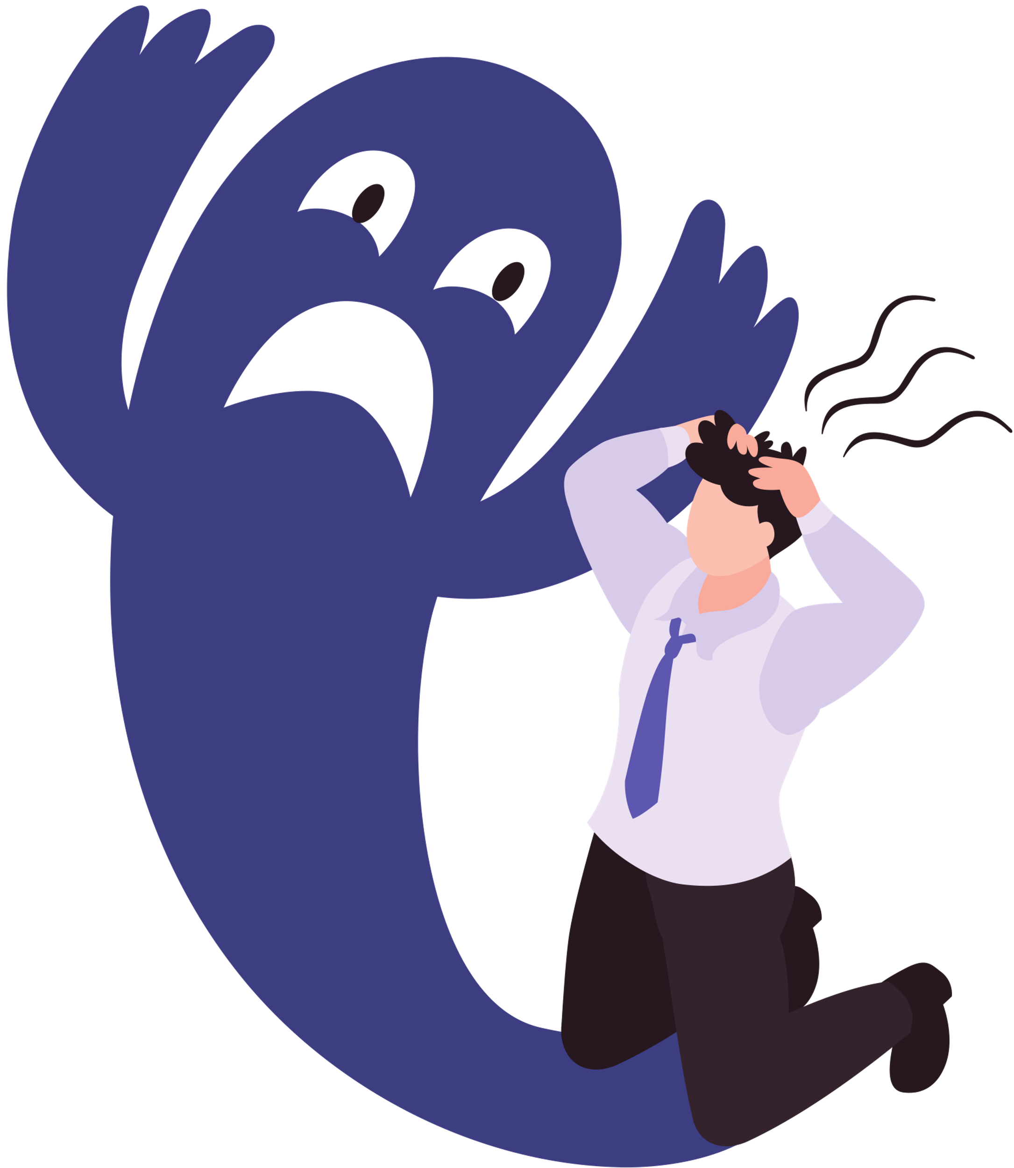
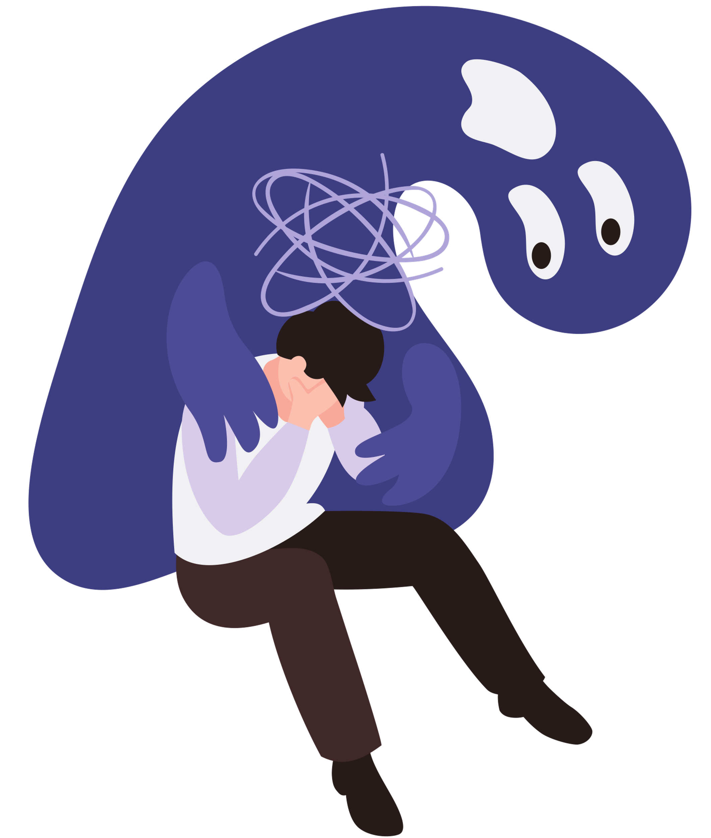
ANXIETY TYPES
Test anxiety
Trait anxiety (general)
State anxiety (temporary or specific)
Panic disorder (feelings of terror)
Social phobia (fear and self-consciousness)
Specific phobias (fear of specific situations)
Notes:
Test: worry about failing, unpleasant feelings about tests
Trait: general sense of anxiety without any particular stimulus, can be a fixed part of your personality and more likely to feel threatened in general
State: anxiety any time you’re confronted with a specific situation (goes away from the situation goes away or changes) Panic: feelings of terror that strike for no reason. Might feel weak, faint, dizzy, chilled. Social: fear of being watched or embarrassed in front of others. (eating, drinking) Phobias: Fears that poses little or no danger.
Anxiety is not always bad though, it’s healthy to be nervous before trying something new. What will this new experience bring? Will I be good at it? Am I going to get hurt? Is it worth trying this new thing? Sometimes it is healthy to decide not to try something new. (i.e. scuba diving with no education or training).

Slide 24
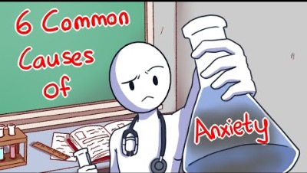
Notes:
https://www.youtube.com/watch?v=w0YC-kj_Ex4&t=23s

Slide 25
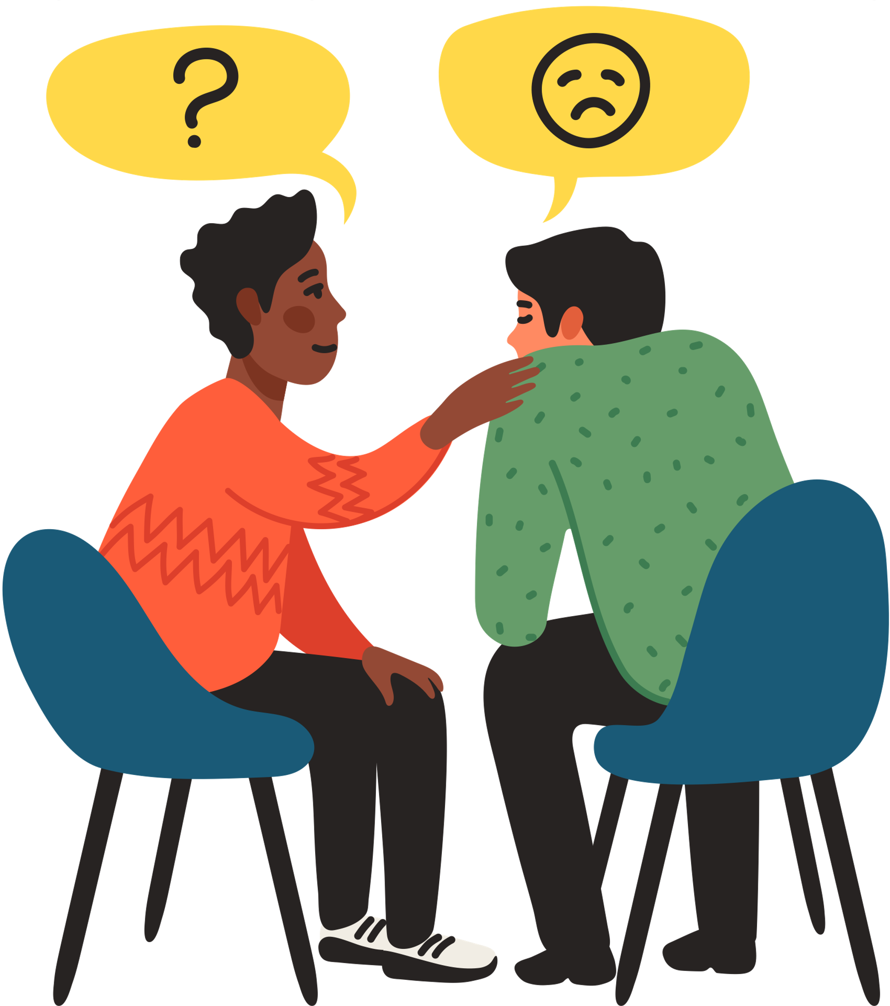
COPING TECHNIQUES FOR ANXIETY
Cognitive restructuring
ABCDE technique
Environmental planning
Relabelling
Self-talk
Thought stopping
Systematic desensitization
Notes:
Cognitive restructuring: Are you going die if you fail the test? The process of identifying and challenging negative and irrational thoughts
Environmental planning: keep away from places that give you anxiety.
Relabeling: negatives into positive (public speaking- a chance to educate)
Self-talk: coaching to yourself- asking questions, giving advice
Thought stopping: Stop and doing something else when having negative thoughts, ex. meditate
Systematic Desensitization: Imagine anxiety provoking situation, the pairing it with relaxation techniques. Start small (fear of spiders- think of a spider, then look at a picture of a spider, and eventually, move on to touching one)

Slide 26
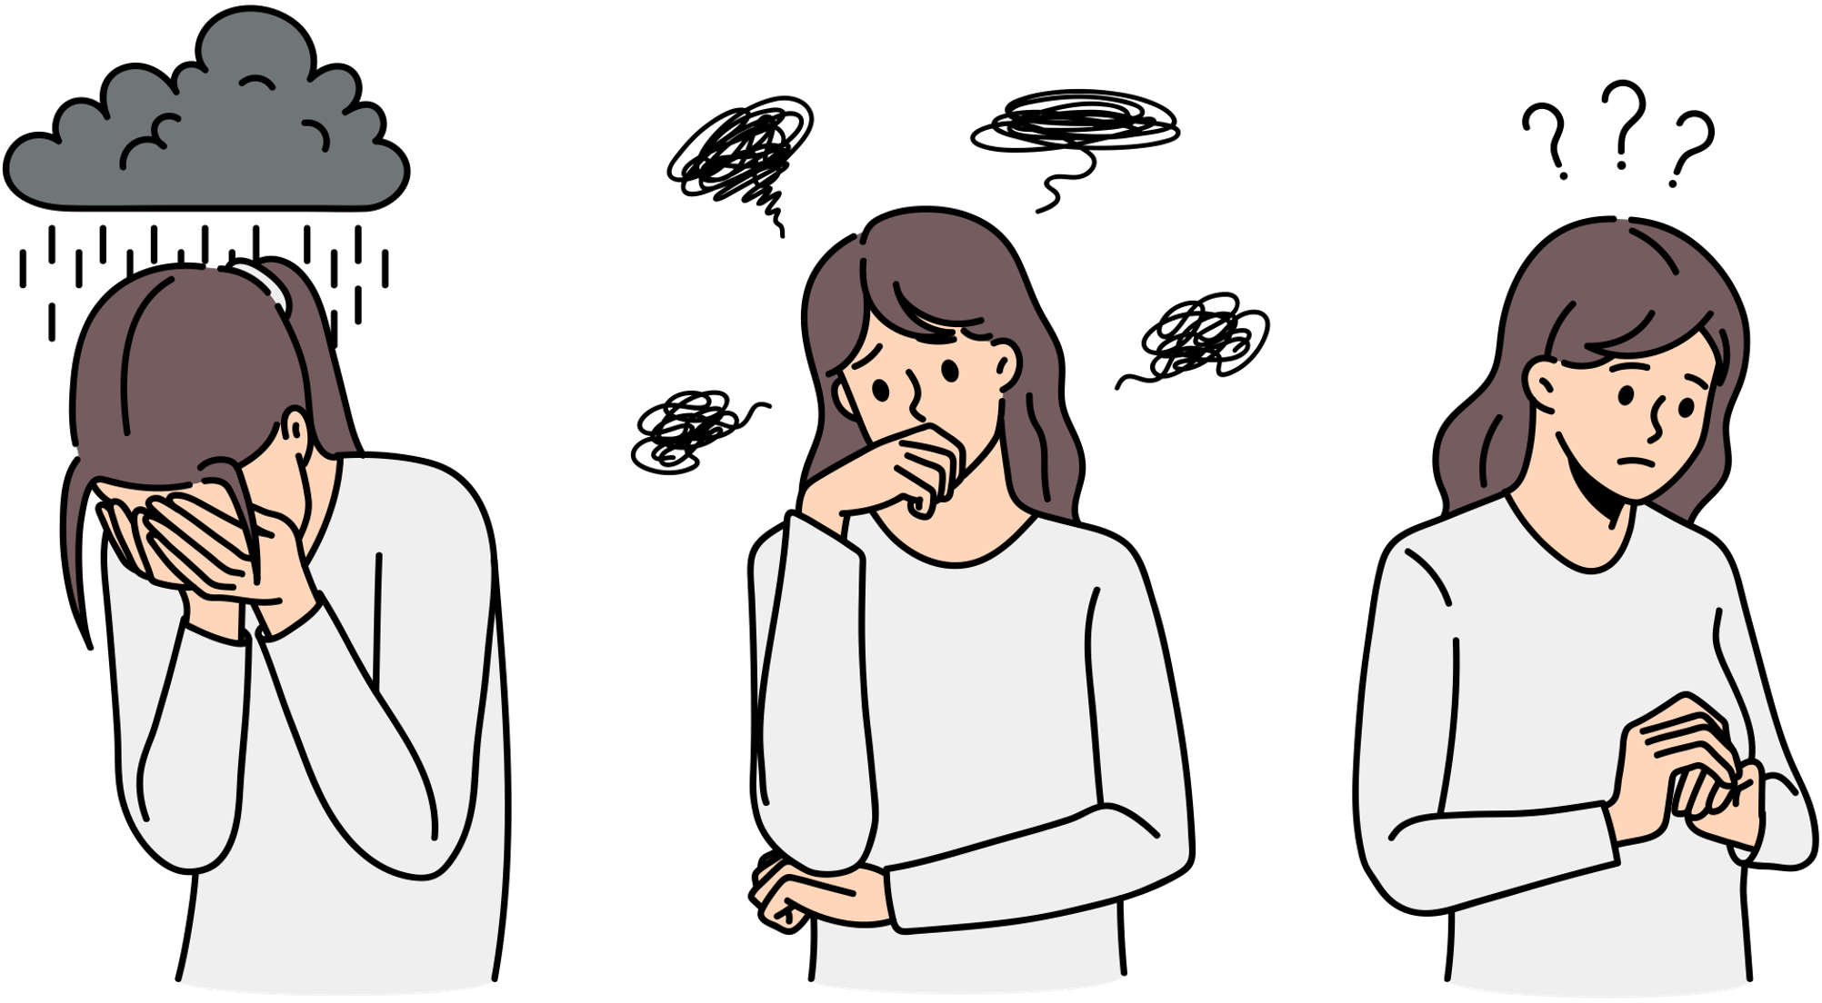
ABCDE TECHNIQUE
A strategy for learning to be optimistic.
Examines irrational beliefs.
Activating agent/adversity
Belief
Consequences
Dispute
Energy
Notes:
This is a method for building optimism by recognizing and disputing pessimistic thoughts. The key to disputing your own pessimistic thoughts is to first recognize them and then to treat them as if they were uttered by an external person, a rival whose mission in life is to make you miserable.
Activating agent – what went poorly?, identify the stress
Belief- the beliefs you automatically have when it occurs. What were you thinking when it happened? What was running through your mind?
Consequences- the usual consequences of the belief. what did you feel and what did you do?
Dispute- put beliefs into perspective, be realistic, try and find evidence. your disputation of your routine belief . Using facts and logic
Energy- how did you feel afterwards? What solutions did you see that you didn’t see before? Did you feel lighter?

Slide 27
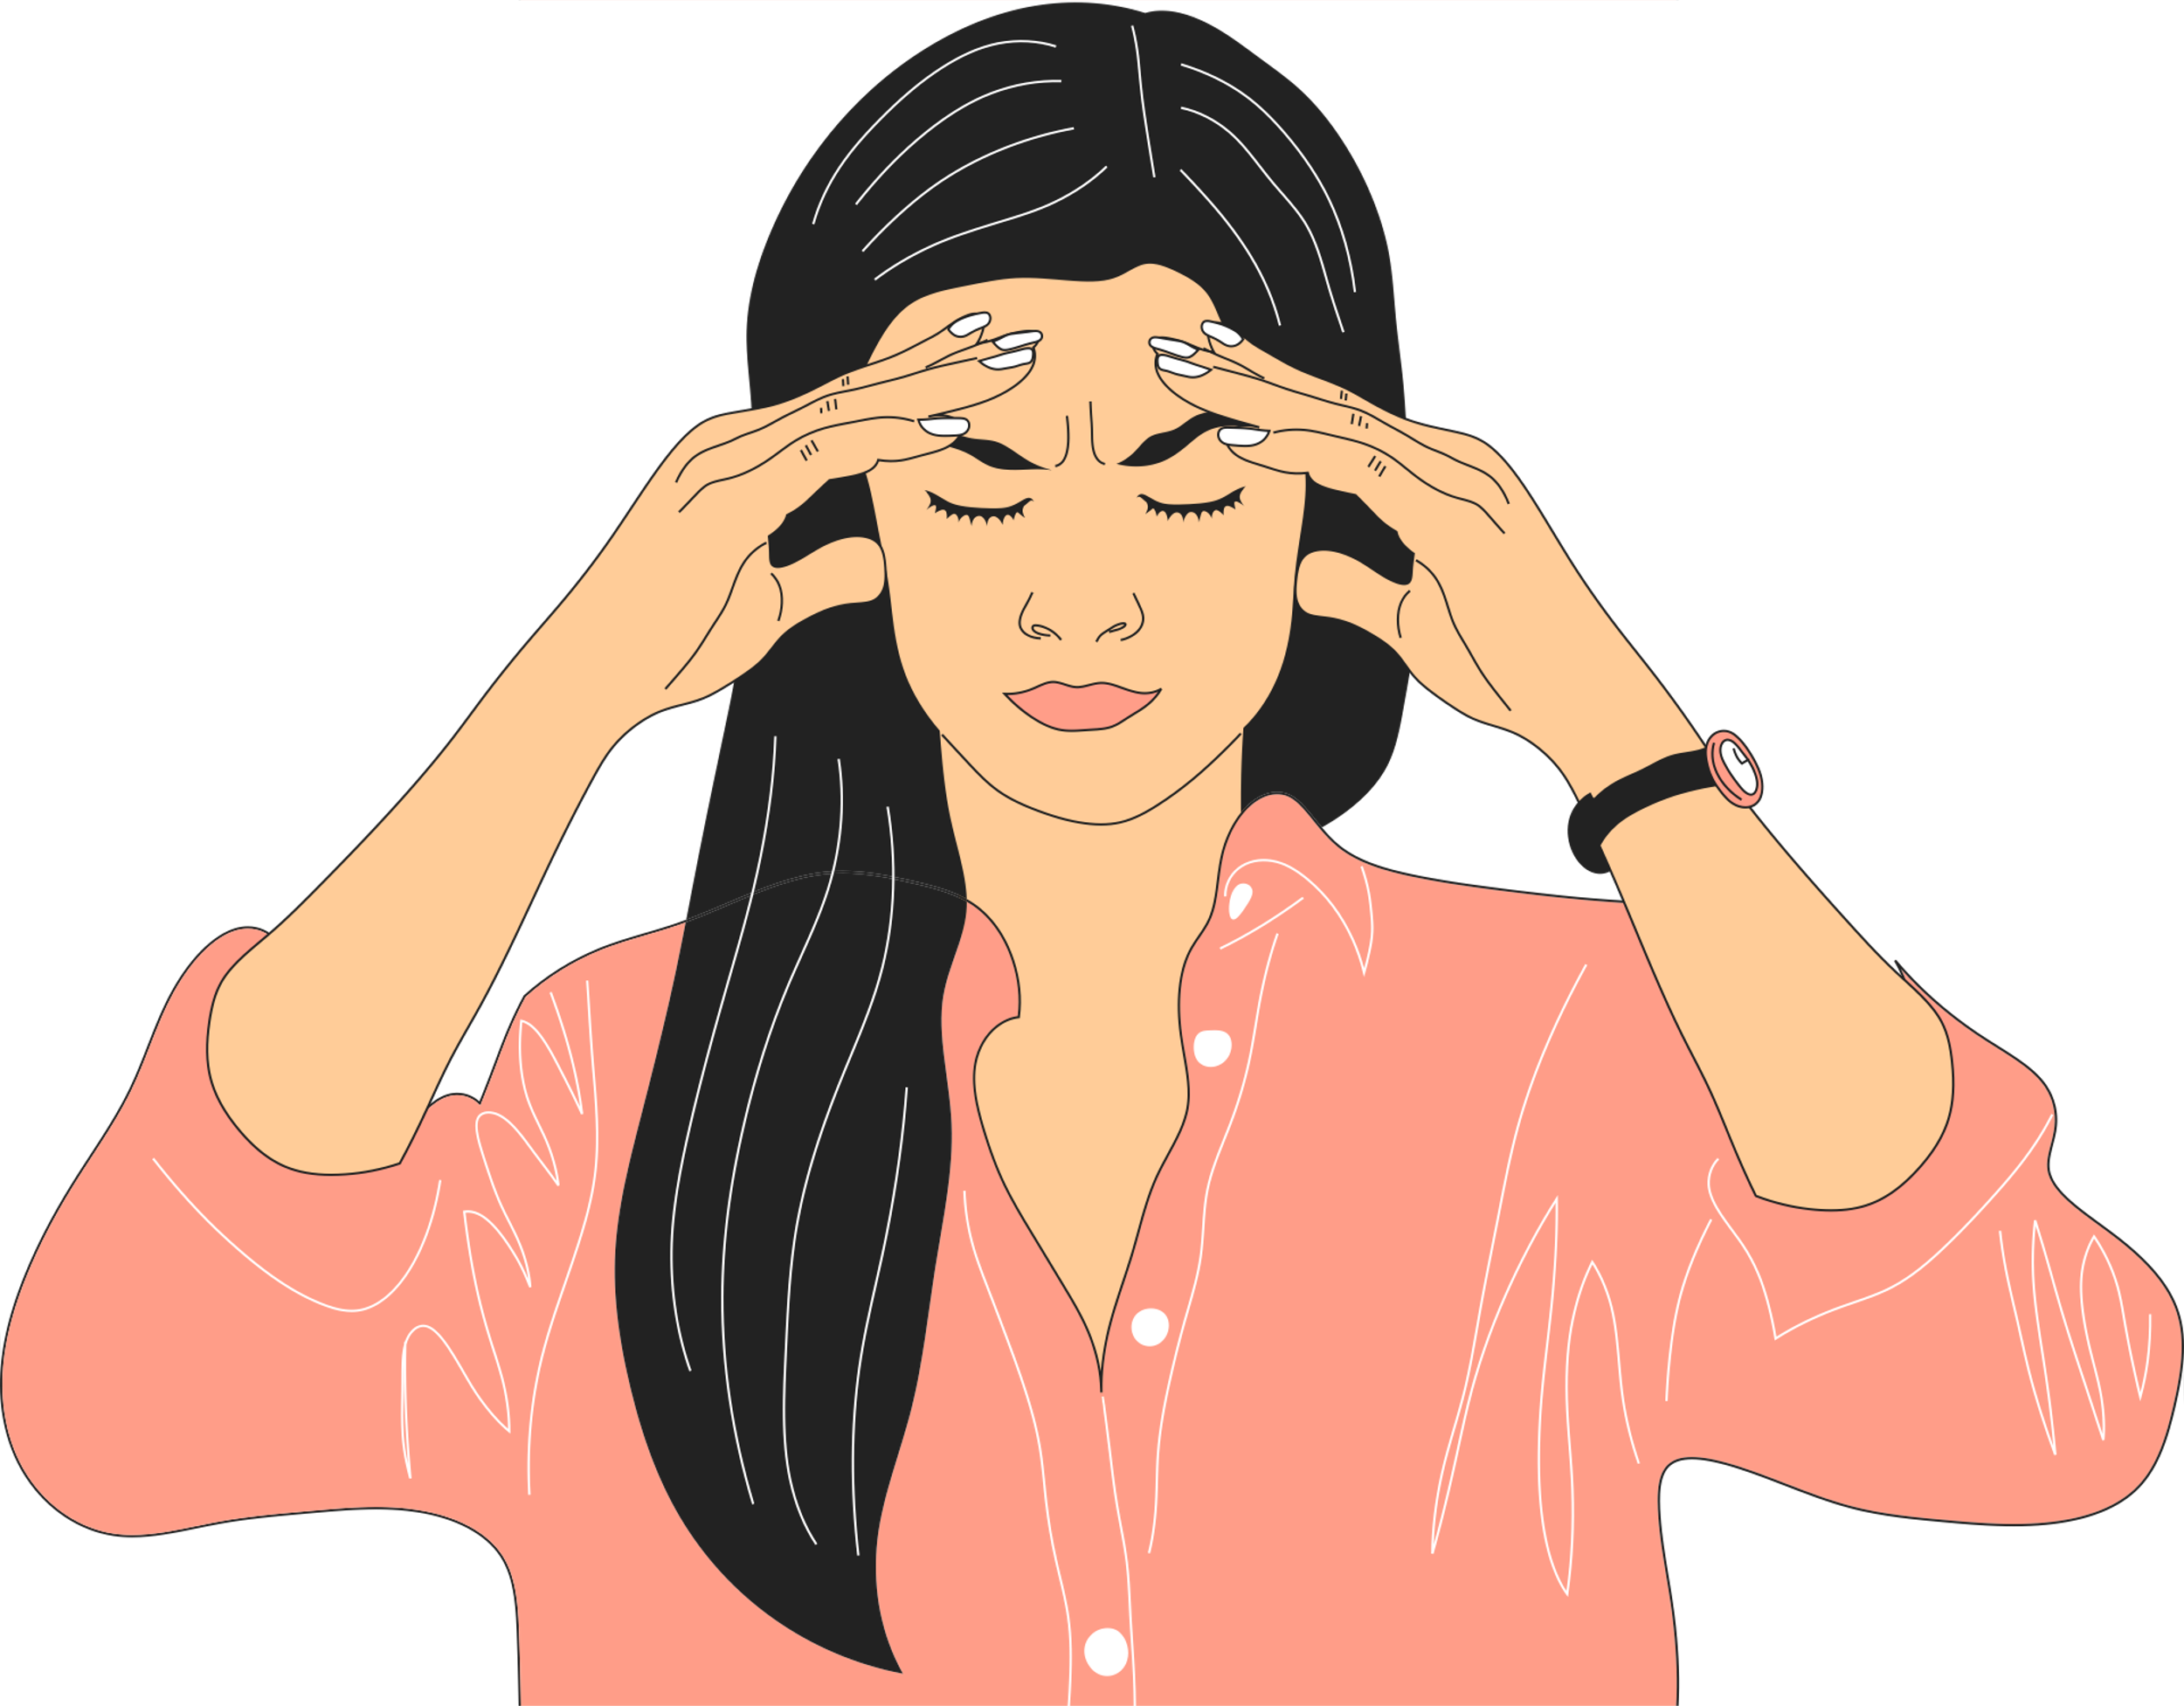
GROUNDING TECHNIQUES
After a trauma, it’s normal to experience flashbacks, anxiety, and other uncomfortable symptoms. Grounding techniques help control these symptoms by turning attention away from thoughts, memories, or worries, and refocusing on the present moment.
Categories
Choose a category and name as many items as you can in each one.
Body Awareness
Directing your focus to sensations in the body by following a series of ?steps.
Mental Exercises
Use mental exercises to take your mind off uncomfortable thoughts and feelings.
Notes:
Body Awareness
Take 5 long, deep breaths through your nose, and exhale through puckered lips.
Place both feet flat on the floor. Wiggle your toes. Curl and uncurl your toes several times. Spend a moment noticing the sensations in your feet.
Stomp your feet on the ground several times. Pay attention to the sensations in your feet and legs as you make contact with the ground.
Clench your hands into fists, then release the tension. Repeat this 10 times.
Press your palms together. Press them harder and hold this pose for 15 seconds. Pay attention to the feeling of tension in your hands and arms.
Rub your palms together briskly. Notice and sound and the feeling of warmth.
Reach your hands over your head like you’re trying to reach the sky. Stretch like this for 5 seconds. Bring your arms down and let them relax at your sides.
Take 5 more deep breaths and notice the feeling of calm in your body.
Mental Exercises
Count backwards from 100 by 7.
Name all the objects you see.
Pick up an object and describe it in detail. Describe its color, texture, size, weight, scent, and any other qualities you notice.
Look at a scene for 30 seconds and then try and remember as many objects as you can.

Slide 28
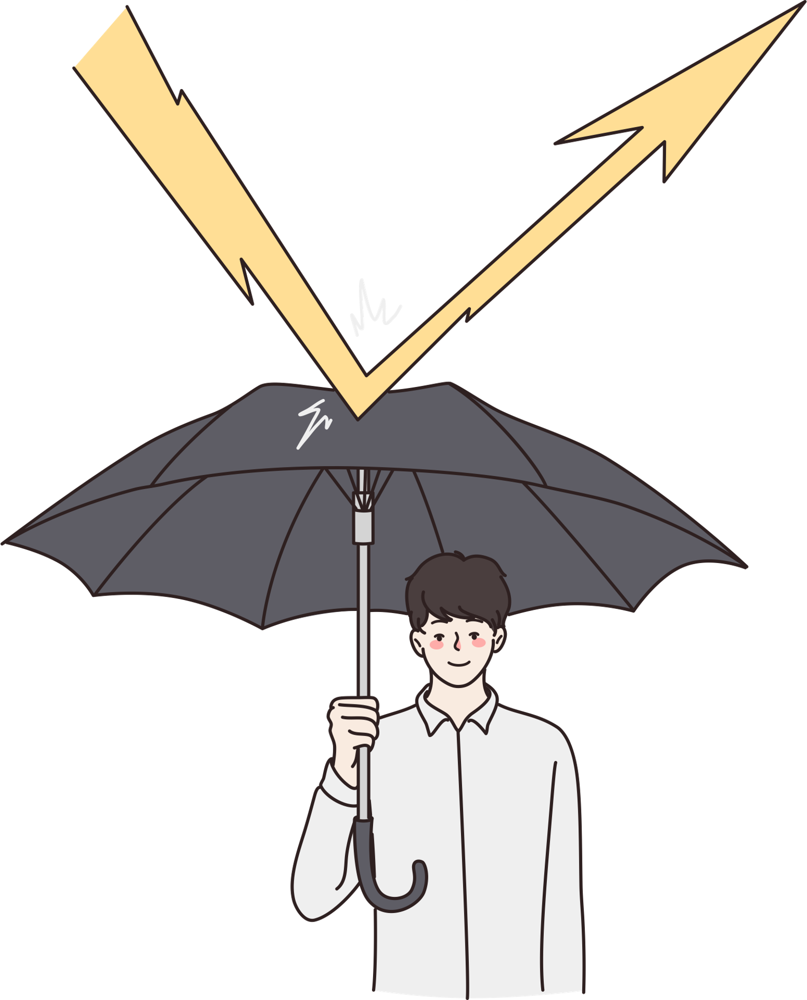
RESILIENCY
The ability to identify and make use of strengths and assets to respond to challenges, thereby growing as an individual
Resilient traits include: happiness, optimism, self-determination, creativity, self-control, gratitude, forgiveness, and humility
Notes:
Found in people who grew up in poverty but become successful as adults.
View challenges as opportunities to learn and grow.
Be more resilient by listing your strengths and how you can use your strengths to overcome situations
People should use their strengths to become resilient based on the situation

Slide 29
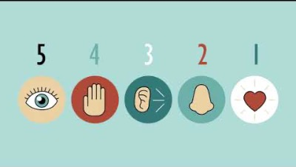
Notes:
5-4-3-2-1 Technique
What are 5 things you can see? Look for small details such as a pattern on the ceiling, the way light reflects off a surface, or an object you never noticed.
What are 4 things you can feel? Notice the sensation of clothing on your body, the sun on your skin, or the feeling of the chair you are sitting in. Pick up an object and examine its weight, texture, and other physical qualities.
What are 3 things you can hear? Pay special attention to the sounds your mind has tuned out, such as a ticking clock, distant traffic, or trees blowing in the wind.
What are 2 things you can smell? Try to notice smells in the air around you, like an air freshener or freshly mowed grass. You may also look around for something that has a scent, such as a flower or an unlit candle.
What is 1 thing you can taste? Carry gum, candy, or small snacks for this step. Pop one in your mouth and focus your attention closely on the flavors.

Slide 30

HARDINESS
People who are hardy have the “3 Cs”
Commitment
Control
Challenge
Hardy people are able to better withstand the onslaught of stressors
Become ill less often from stressors
Have less psychological distress, increased happiness and adjustment, happier marriages
Notes:
Describes a combination of personality characteristics that may facilitate a positive perception of events. A hardy individual is less likely to experience negative symptoms of stress when encountering a stressful experience. A hardy individual is characterized by:
Commitment: It refers to persevering or sticking it out through a hard time. Being committed to an outcome keeps us going even in the midst of setbacks, obstacles, and discouraging news. To commit, set realistic goals and plan punishments for not fulfilling the contract.
Control: In a tough situation hardy individuals do not become overwhelmed or helpless. Instead, they strive to gain control of what they can by going into action. While acknowledging it is true that many aspects of a crisis situation cannot be controlled, they also understand that by intentionally developing and holding onto a positive, optimistic, hopeful outlook
Challenge: Psychologically hardy individuals see problems as challenges rather than threats. This difference is important because when faced with a threat, there is a tendency to try and avoid it. Hardy people see problems as challenges and rather than being overwhelmed and seeking to retreat, they get busy looking for solutions.

Slide 31
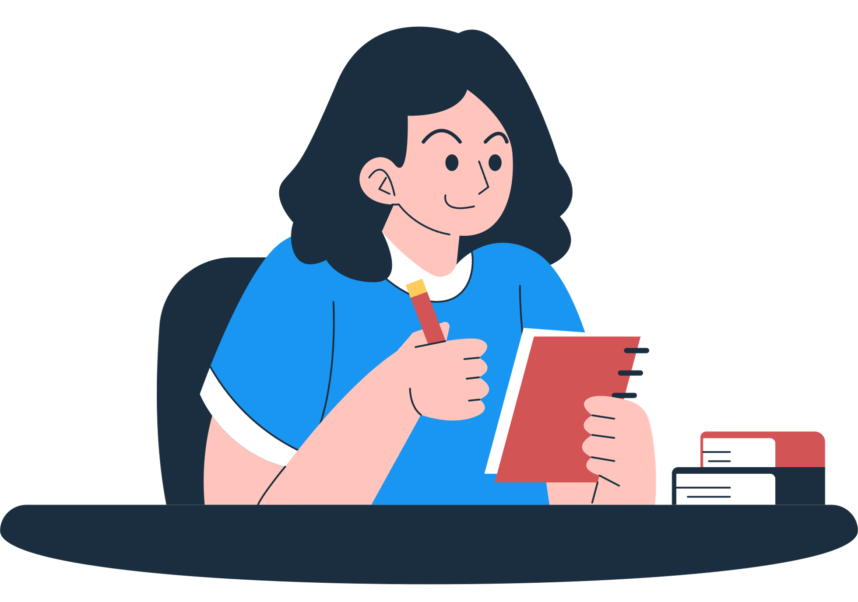
TAKING CONTROL
Managing stress means exercising control rather than giving up
You can decide whether to control or not control the stress response
Practicing specific techniques as a means of taking control and assuming responsibility
Employing stress management techniques in a stressful way is dysfunction
Notes:
If possible, try to reduce the stress at its source. Ex. If you feel like you have too many chores, ask for help.
If these techniques are not possible, then use relaxation or thought management.

Slide 32
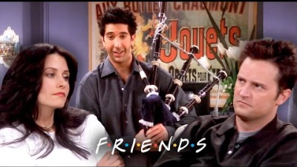
MINDFUL MOMENT
Notes:
https://youtu.be/KvyF2PIJ694

Slide 33

MINDFUL MOMENT
Notes:
Bloopers from the previous scene

